Slide 1
GPMS: Enabling Indoor GNSS Positioning using Passive Metasurfaces
MobiCom 2024
Yezhou Wang† ¶, Hao Pan¶, Lili Qiu ¶*, Linghui Zhong ‡ ¶, Jiting Liu ♦¶, Ruichun Ma ₣ ¶,
Yi-Chao Chen†, Guangtao Xue†, Ju Ren€
Shanghai Jiao Tong University† Microsoft Research Asia¶ UT Austin*
Central South University ‡ Columbia University♦ Yale University₣ Tsinghua University€
Notes:
Hello, I am Ye Zhou Wang from Shanghai Jiao Tong University.
On behalf of all the authors, I am pleased to introduce our latest work: GPMS: Enabling Indoor GNSS Positioning using Passive Metasurfaces. This work was done during my internship at Microsoft Research Asia.

Slide 2
Global Navigation Satellite System (GNSS)
4 Mainstream GNSS Constellations
Notes:
GNSS stands for global navigation satellite system, and we list the mainstream four GNSS constellations here, they are GPS from the United States, Galileo from the European Union, GLONASS from Russia, and Beidou from China.

Slide 3
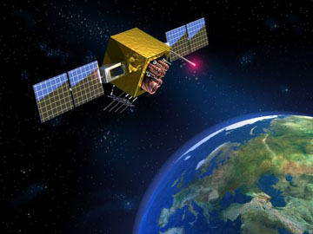
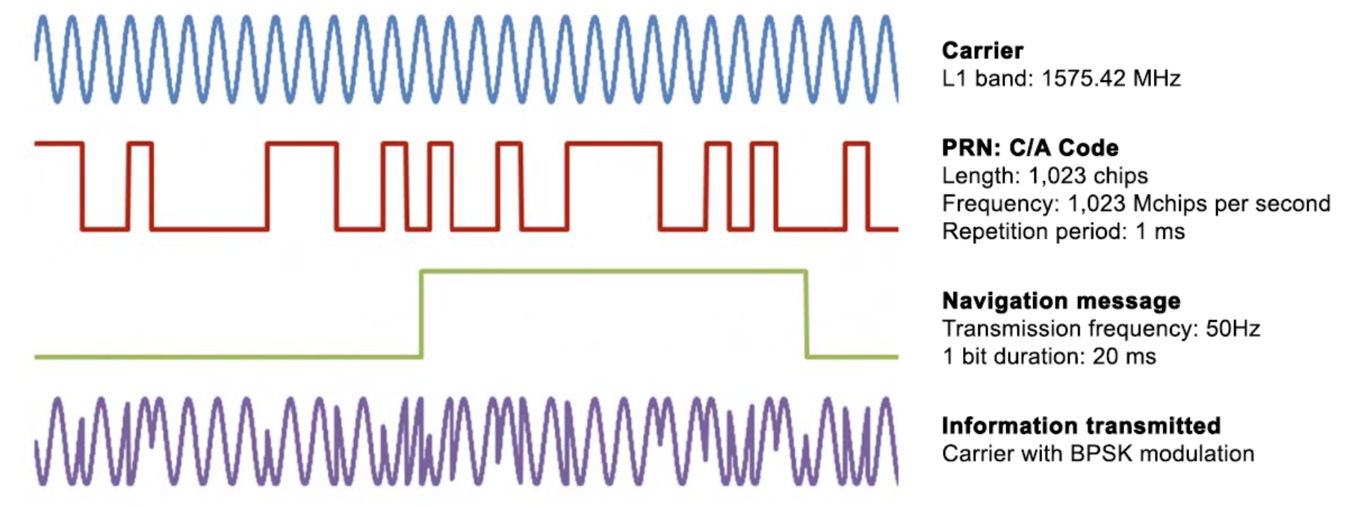
Global Navigation Satellite System (GNSS)
GNSS Satellite sends signal
from SPACE to GROUND
TX power: 500W
strong path loss
RX at ground: 1.4 x 10⁻¹⁶ W
500 W
1.4 x 10⁻¹⁶ W
4 satellites -> (X,Y, Z, T)
Localization error (outdoor)
~1 meter
Notes:
GNSS stands for global navigation satellite system, it can provide geospatial positioning with global coverage.
[CLICK] So how GNSS works? GNSS relies multiple satellites and triangulation algorithm to implement the global localization. Considering that the time between the satellites and the ground receiver is not synchronized, it is necessary to use at least four satellites to achieve accurate localization, that is to get the user's position (x, y, z) and the local time T.
[CLICK] Due to the serve path loss of the EM waves from space to the earth ground, the received signal strength is very small at the ground. Therefore, [CLICK] GNSS need the special coding and decoding techniques to recover the original data in the case of low SNR.

Slide 4
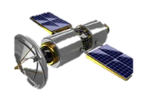
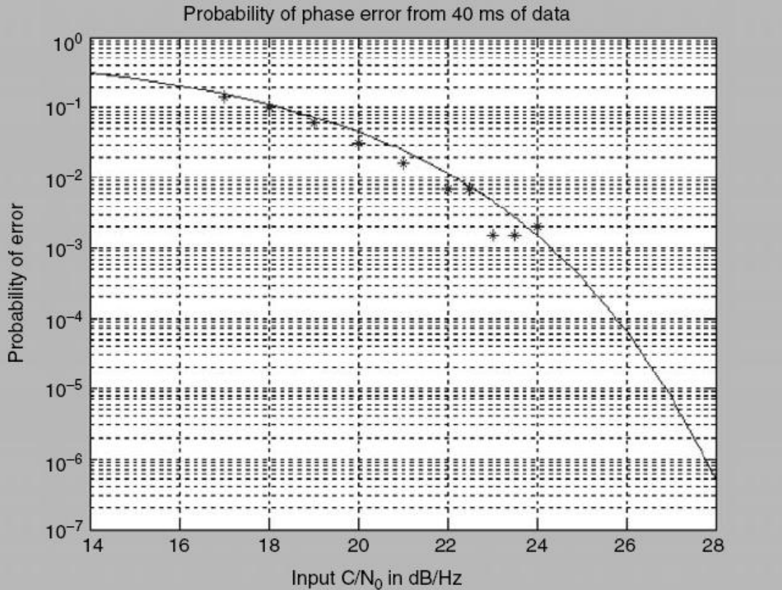
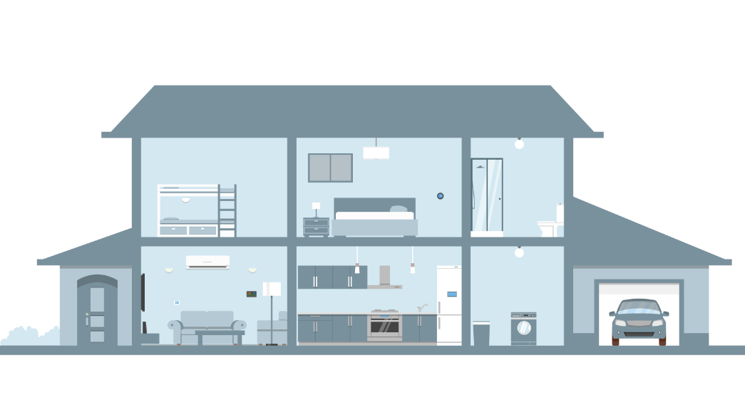
When GNSS comes to indoors
500 W
GPS signal outdoors:
~10⁻¹⁶ W ≈ -130 dBm
C/N0 <= 22dB
RSS <= -150dBm
BG noise power = -172Bm
GPS signal indoors:
~10⁻¹⁸ W ≈ -150 dBm
We CANNOT decode GNSS signals with such a low signal strength indoor.
Notes:
According to our experience, we can find that GNSS can generally achieve good localization in outdoor scenarios, but it is difficult to use in indoor scenarios. This is because, indoor scenes usually have low SNR of the received GNSS signals.
[CLICK] As you can see from the right figure, if the SNR of the received signal is less than about 22dB, that is, the received model strength is less than minus 150dBm, the error rate of the GNSS signal decoding rate will be particularly high.
[CLICK] Therefore, we cannot decode GNSS signals with such a low signal strength indoor.

Slide 5
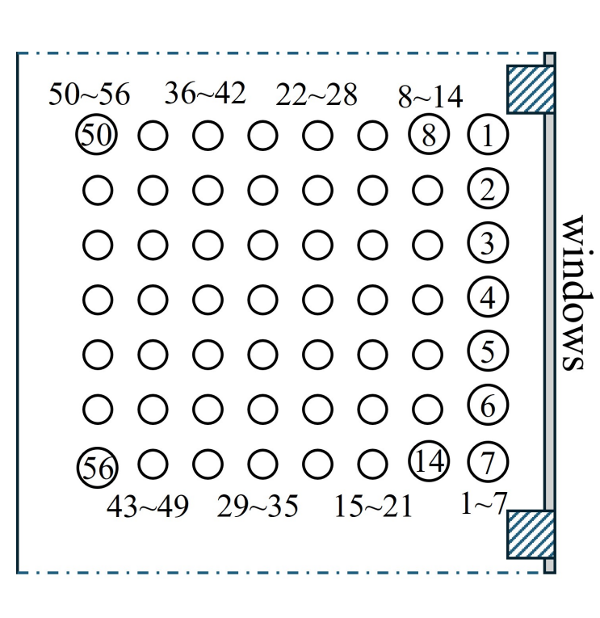
Indoor GNSS measurements
Real-world measurement setup
Top view
Notes:
We deployed a 7 x 8 array of sensors and conducted measurement experiments in a real-world indoor scenario, to further understand the propagation and distribution of GNSS signals indoors

Slide 6
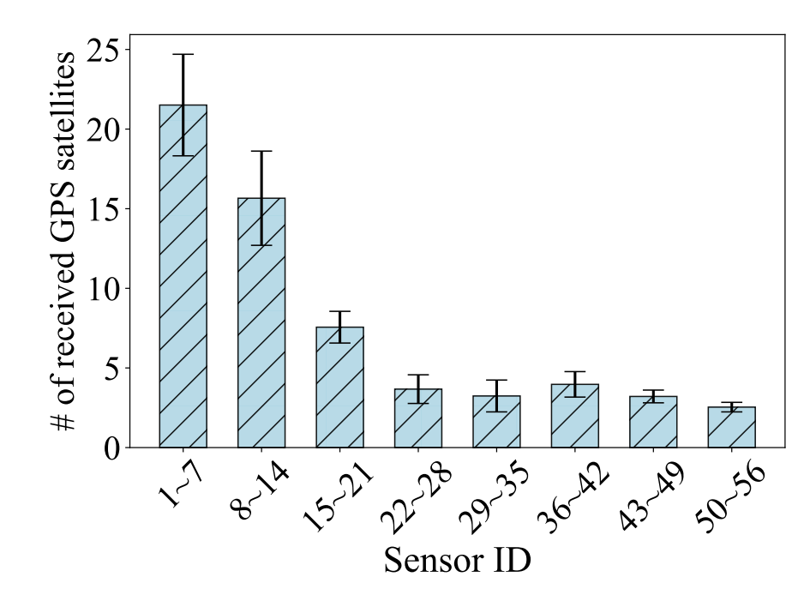
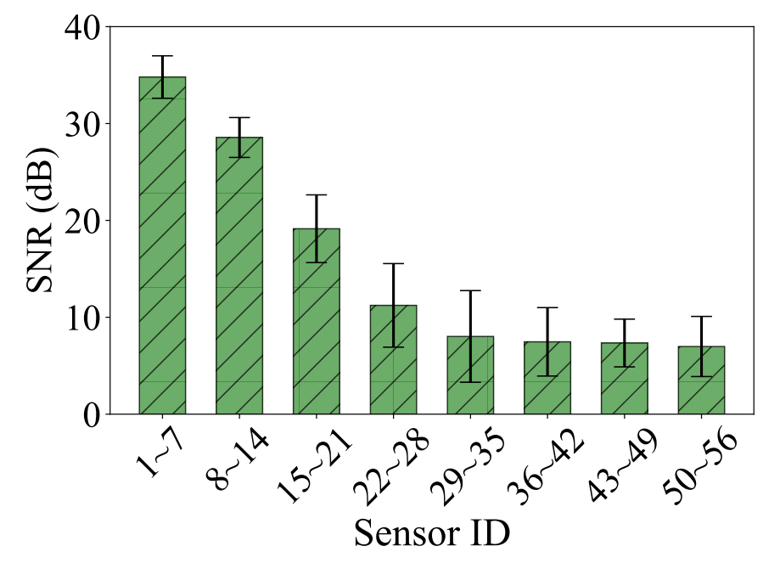
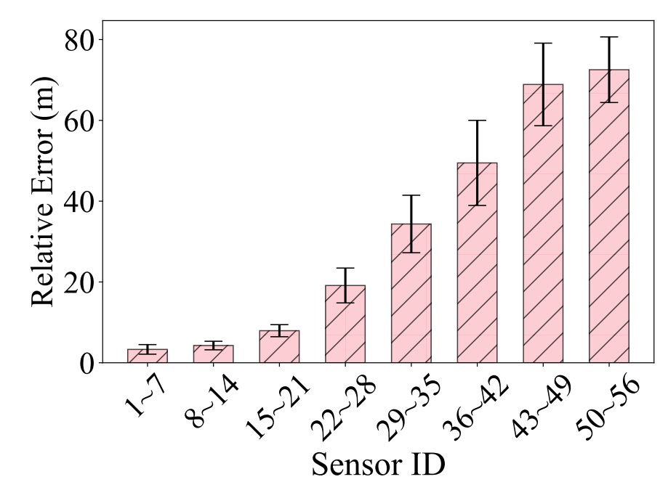
Indoor GNSS measurements
The closer to the window, the higher the number of received GPS satellites
The closer to the window, the higher SNR of received signals
The closer to the window, the smaller the positioning error
Notes:
Our experimental data show that: The closer to the window, the higher the number of received GPS satellites.
[CLICK] And the closer to the window, the higher SNR of received signals.
[CLICK] And, the closer to the window, the smaller the positioning error.
Therefore, we conclude that if we enhance the number of available satellites received by the GNSS receiver indoors, as well as the SNR of the received GNSS signals, we can effectively reduce the positioning error.

Slide 7
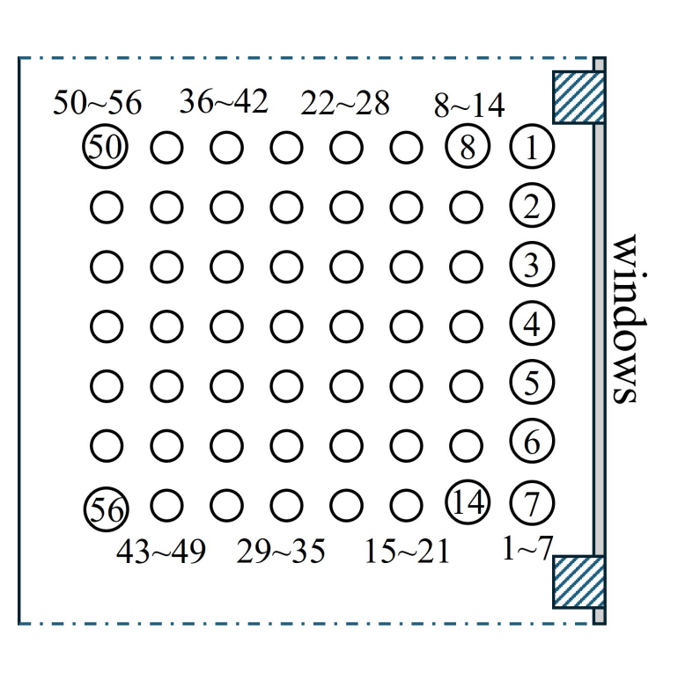
Indoor GNSS measurements
Sky plot
All received GPS traces over 24 hours
At the position near the window, the greater the angle of incidence, the greater the SNR of the received signal.
Notes:
We recorded data from the sensor at position 4 for 24 hours and then plotted the received GNSS satellite data in a sky plot.
[CLICK] we found that the window position can receive signals from satellites at different elevation angles, and the higher the elevation angle, the stronger the signal.
Satellites with small elevation angles have a much lower SNR to reach the same location because the transmission distance is much longer.

Slide 8
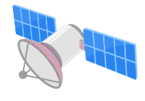
Why low SNR of GNSS signals indoors
Two mainly reasons:
1. Windows are good GNSS incidence areas, but reflections can attenuate the signal power
Can we make GNSS serve for indoor positioning?
2. Severe attenuation of GNSS signals by walls
Shopping mall
(indoor environment)
Notes:
So let's summarize the first reason why GNSS signals don't reach indoors effectively.
It is that the although GNSS signal with a relatively high elevation angle can penetrate the windows to the indoor area, but its attenuation due to multiple reflections causes it not to reach the indoor area far away from the window.
[CLICK] The other obvious reason is that the wall of the building itself attenuates the GNSS signal very much.
So, the problem is Can we make GNSS work for indoor scenarios?

Slide 9
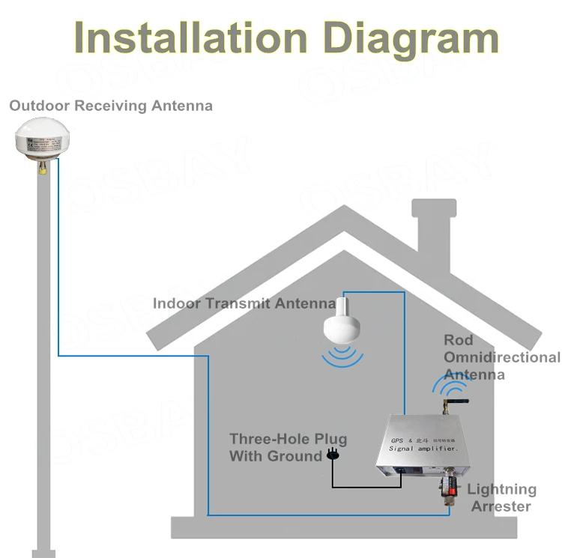
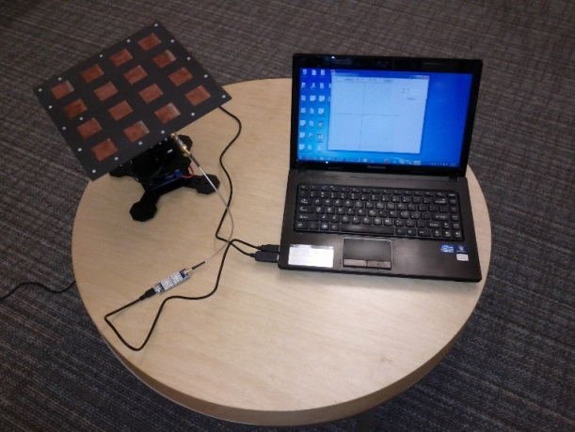
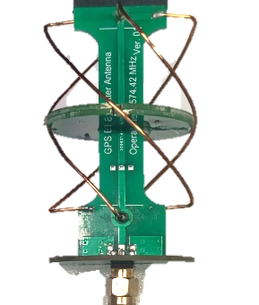
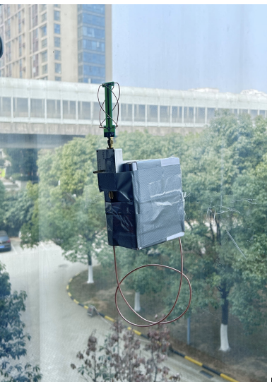
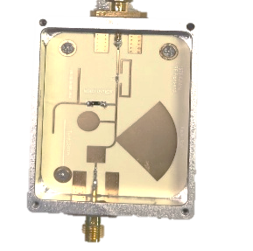
Existing solutions for indoor GNSS
1. Larger RX antenna
2. GPS Repeater (Active)
3. Backscatter (Passive)
Drawbacks:
Need specialized equipment
Large, expensive, not easy to deploy
Drawbacks:
Need power supply
Need long cable to connect outdoor RX antenna and indoor TX antenna
Drawbacks:
Need to be place outdoor
Over two satellites should a line of sight (LOS) to the receiver
Need cables to connect each other for clock synchronization
[1] Nirjon, Shahriar, et al. "COIN-GPS: Indoor localization from direct GPS receiving." MobiSys '14
[2] GPS Repeaters - Indoor GPS coverage from FalTech (gps-repeaters.com)
[3] Dong, Huixin, et al. "GPSMirror: Expanding Accurate GPS Positioning to Shadowed and Indoor Regions with Backscatter." Mobicom '23
Notes:
Currently, there are three ways to improve indoor positioning.
First, users can use larger antennas, but this requires specialized equipment. These larger antennas are also bulky, expensive, and not easy to deploy.
Second, we can employ active GPS repeaters. This involves placing an outdoor receiving antenna and using a power cable to connect it with an indoor transmitting antenna. However, this system requires a power supply and a lengthy cable to connect the outdoor receiving antenna with the indoor transmitting antenna.
The third method involves using backscatter technology. However, the backscatter tags themselves need to be placed outdoors and must maintain a line of sight (LOS) to the receiver. Additionally, if multiple tags are used to enhance indoor positioning, they require cables for interconnection.

Slide 10
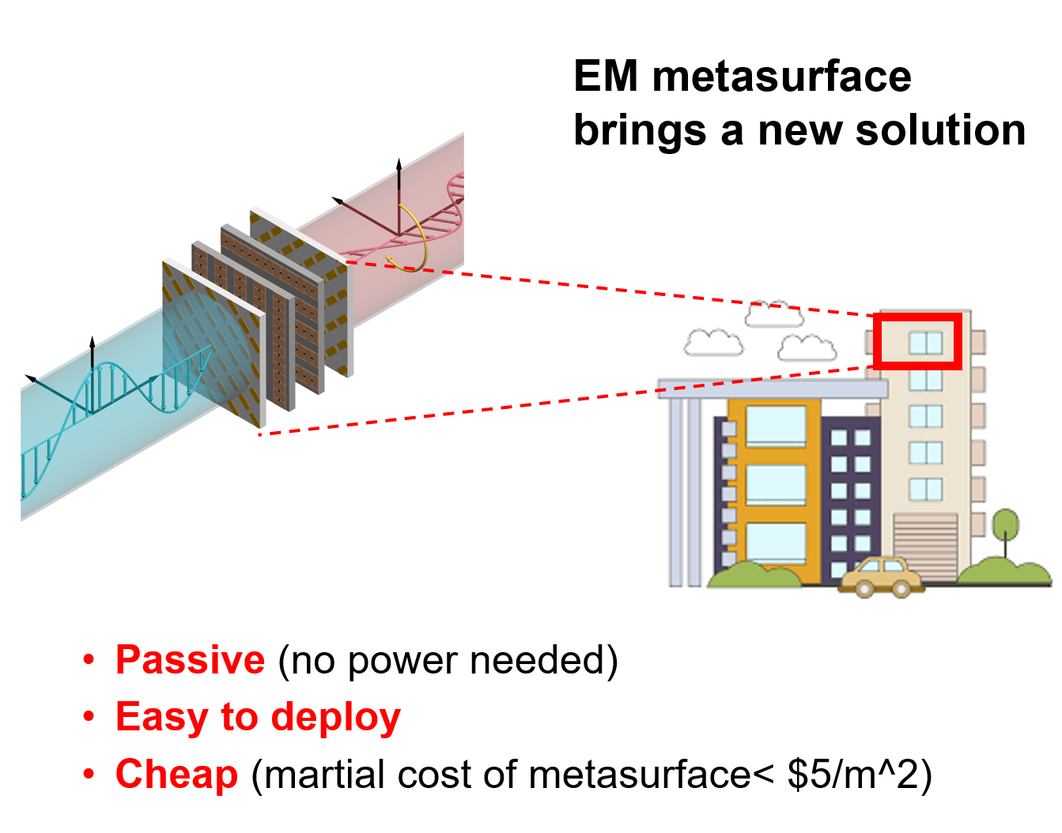
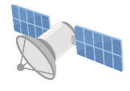
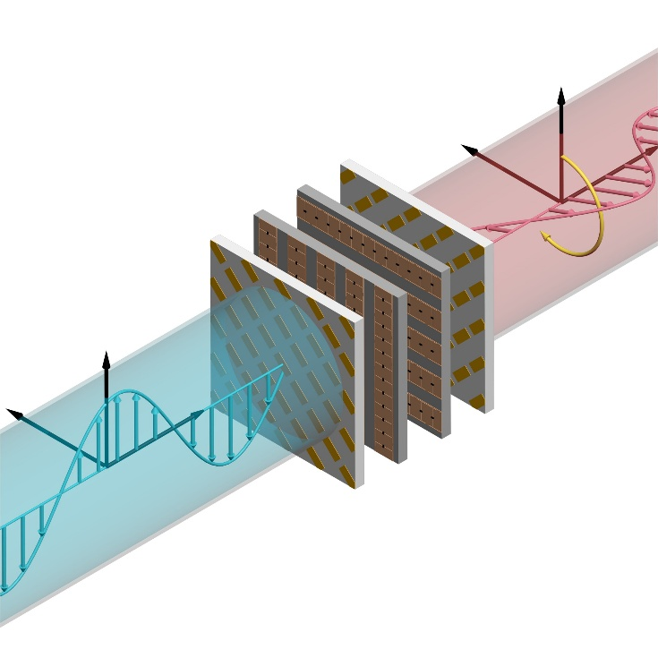
Our idea: Design passive metasurface to
enhance GNSS signals indoors
EM metasurface brings a new solution
GNSS satellites
Metasurface
Metasurface
Steering and scattering
Steering and scattering
Metasurface
Steering and scattering
Shopping mall
(indoor environment)
Passive (no power needed)
Easy to deploy
Cheap (martial cost of metasurface< $5/m^2)
Attach metasurface on the windows and walls
Notes:
EM metasurface, as a special component that can control the transmission of electromagnetic waves, bring a completely new solution.
Our idea is to Design passive metasurface to enhance GNSS signals indoors
[CLICK] If we deploy well-designed metasurfaces on windows and walls, and then effectively steer and scatter GNSS signals to the indoor area, in this way, we can receive high-quality GNSS signals indoors.

Slide 11
Our idea: Effective steering and scattering
Challenges:
Metasurface design
GNSS satellites are moving, and have different incident angles
Indoor users are also moving and everywhere
GNSS satellites
Metasurface
2
Powerful steering for any incident angles
Metasurface
3
Metasurface
1
Powerful scattering for maximum coverage
Steering and scattering
Indoor positioning algorithm design
Satellite -> mts -> user
Novel indoor positioning compatible with deployed metasurfaces
Deploy metasurfaces on the windows and walls
Notes:
However, designing such a metasurface to enhance indoor GNSS is extremely challenging.
The first challenge is the design of the metasurface itself, since GNSS satellites are always moving on space, and, users in indoor environments are also in continuous motion. [CLICK] This suggests that the metasurface we design needs to be able to have strong and consistent steering of GNSS signals at different incidence angles of satellite signals, as well as scattering of GNSS signals to achieve as much coverage as possible.
[CLICK] The second challenge is the design of indoor localization algorithms. [CLICK] Because the GNSS signals relayed to the indoor through the metasurface makes the whole transmission path become, from the satellite to the metasurface and then to the user, which requires us to implement a new positioning algorithm compatible with the deployed metasurface.

Slide 12
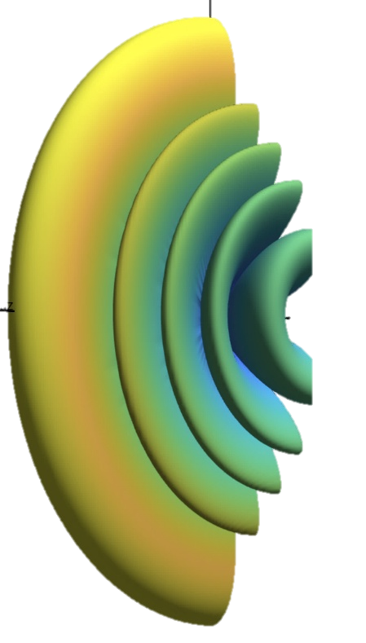
Macroscopic: Metasurface design (phase map) for GNSS
$$S_{m}$$
Near-field
channel
$$H$$
Far-field
channel
$$G_{m}$$
GNSS
satellites
…
Target radiation matrix
$$D(α, β)$$
$$S_{1}$$
…
Users
Metasurface 1
$$M_{1}$$
Metasurface 2
$$M_{2}$$
Metasurface Assembly System
Notes:
So, for the first challenge, our goal is to design a metasurface system that enables efficient steering and scattering of signals generated by GNSS satellites at different elevation angles.
Trying to do the above with a passive metasurface is difficult. Inspired by the optical lens combination, [CLICK] we try to realize the general steering and scattering metasurface system by combining multiple sub-metasurfaces.

Slide 13
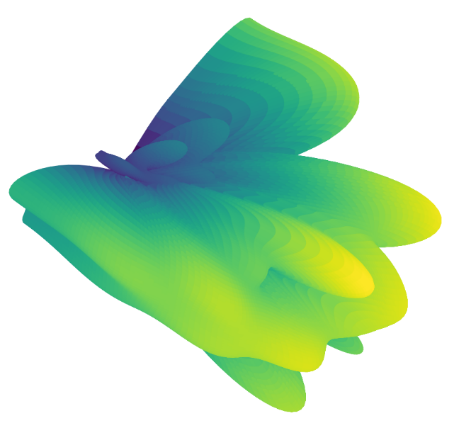
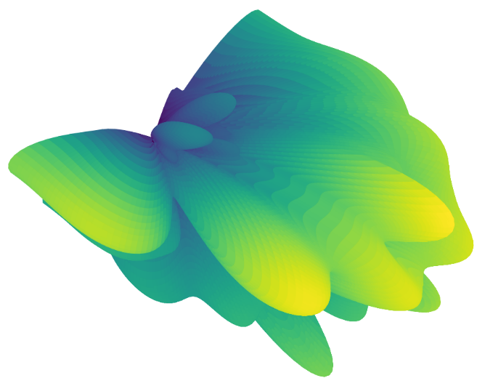
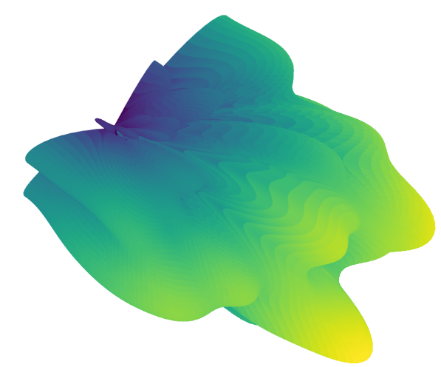
Macroscopic: Metasurface design (phase map) for GNSS
$$S_{m}$$
Far-field
channel
$$G_{m}$$
Near-field
channel
$$H$$
Radiation out from mts
$$P\left(α, β,W\right)$$
Target radiation matrix
$$D(α, β)$$
…
$$S_{1}$$
Metasurface 1
$$M_{1}$$
Metasurface 2
$$M_{2}$$
Notes:
Let's take two metasurfaces as an example, metasurface1 and metasurface 2 will form a larger metasurface. And in this way, we need to determine the design of these two sub metasurfaces to achieve efficient steering and scattering of signals from the satellite.
Here, the goal we want to optimize is very clear, we need to determine the most available M1 and M2, so that after the wavefront control of M1 and M2 for the different satellite signals [CLICK] [CLICK] [CLICK] the final radiation map out from the M2 can be as close as possible to the target radiation pattern.

Slide 14
Macroscopic: Metasurface design (phase map) for GNSS
$$S_{m}$$
Near-field
channel
$$H$$
Far-field
channel
$$G_{m}$$
GNSS
satellites
…
Radiation out from mts
$$P\left(α, β,W\right)$$
$$S_{1}$$
…
Metasurface 1
$$M_{1}$$
Metasurface 2
$$M_{2}$$

Slide 15
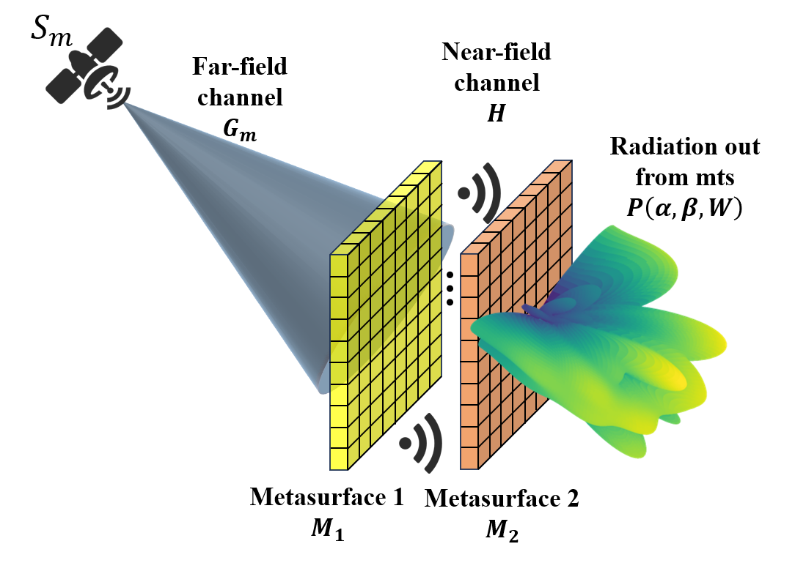
Macroscopic: Metasurface optimization model
Element weights radiated out from metasurface 2:
$$W= G_{m}M_{1}{HM}_{2}$$
Radiation pattern radiated out from metasurface 2:
$$P\left(α, β,W\right)= \frac{AF(α, β,W)}{max(AF(α, β,W))}$$
where
Optimization Problem: for all GNSS satellite signals, we determine the optimal $M_{1}$ and $M_{2}$ to make the radiation patterns from the metasurfaces close to the target radiation pattern.
$$\min{\sum_{m=1}^{K}{\iint{{\left(P\left(α, β,W\right)−D\left(α, β\right)\right)}^{2}dαdβ}}}$$
Notes:
We performed detailed mathematical modeling and used a gradient descent solver to find the optimal metasurface design.

Slide 16
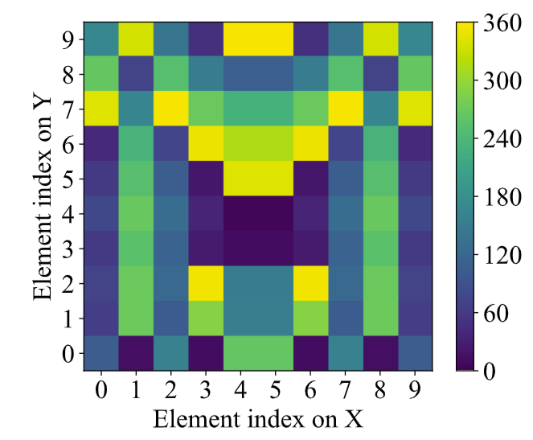
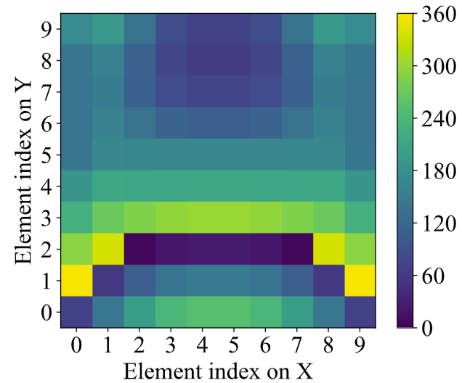
Optimized metasurface design
Metasurface 1’s phasemap
…
Metasurface 2’s phasemap
Metasurface 1
$$M_{1}$$
Metasurface 2
$$M_{2}$$
Notes:
The phase map of the optimized metasurfaces are shown here, [CLICK] these two metasurfaces are composed of 10x10 elements

Slide 17
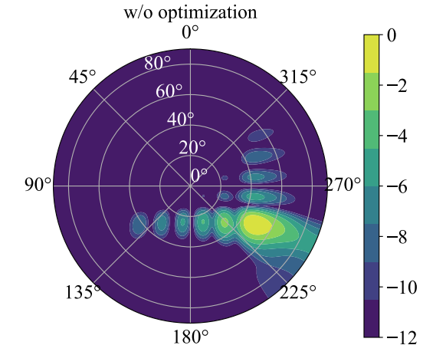
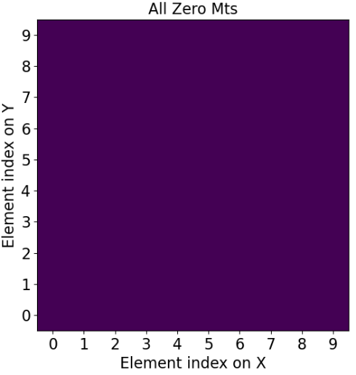
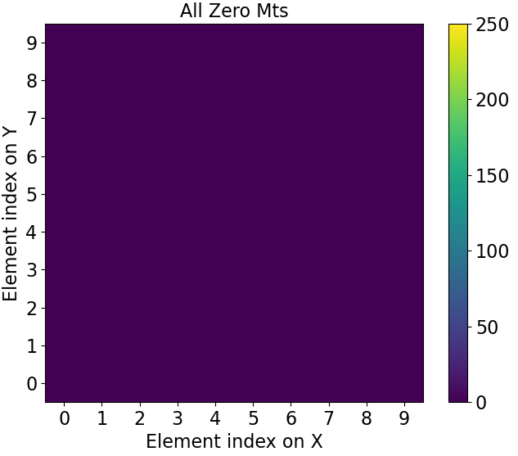
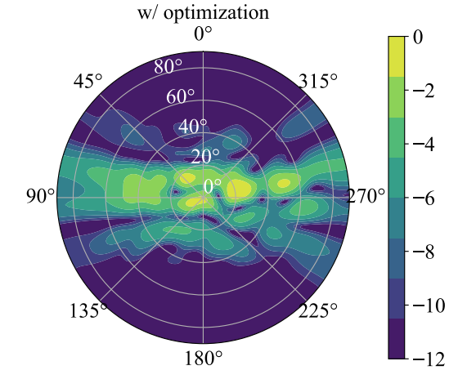
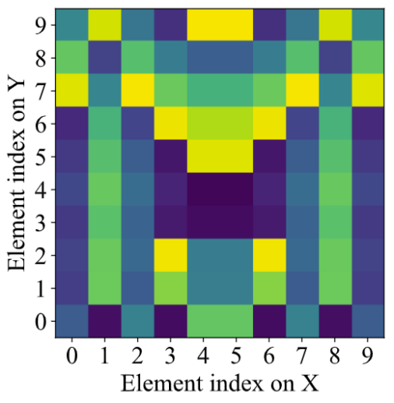
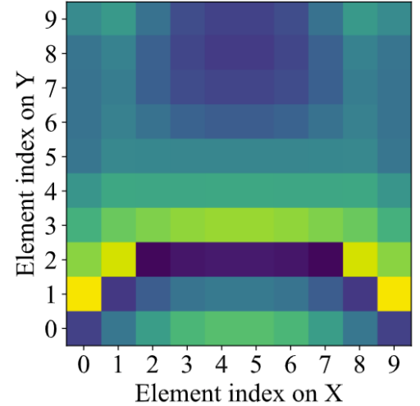
Comparison of not using optimized mts vs. using optimized mts
No optimization
Metasurface 1
Metasurface 2
Optimization results
Metasurface 1
Metasurface 2
Notes:
We first show the no-optimized metasurfaces’ results, and [CLICK] then we show the optimized results. We find that our optimized metasurface can indeed steering and scattering the satellite signals effectively.

Slide 18
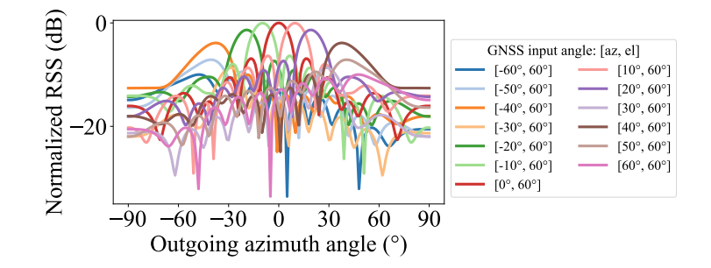
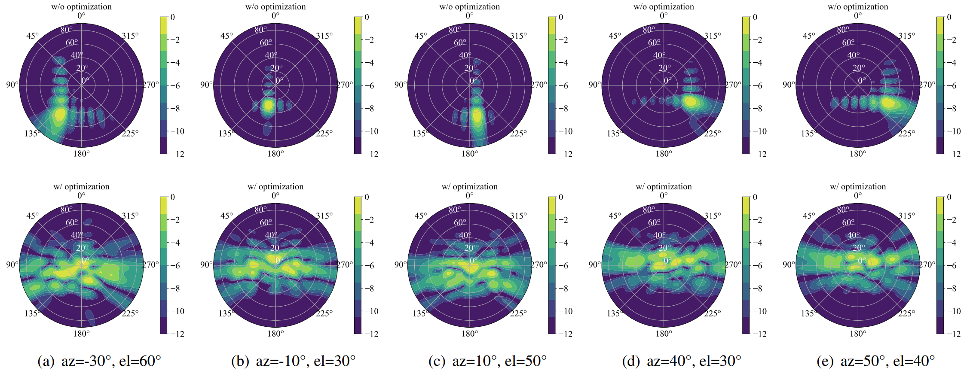
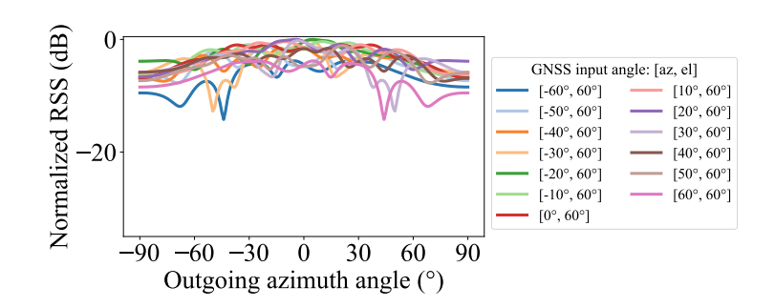
Simulation: scattering and steering performance
How to design an indoor positioning algorithm that is COMPATIBLE with metasurfaces?
Metasurface
Steering and scattering
Metasurface
Steering and scattering
Notes:
Moreover, our optimized metasurface achieves consistent steering and effective scattering for satellite signals at different incidence angles. [CLICK] Therefore, by deploying the optimized metasurface on the window, we can achieve the introduction of GNSS signals into the room with high signal quality and large coverage. [CLICK] Here, we solve the first challenge. And the second one is How to design an indoor positioning algorithm that is COMPATIBLE with metasurfaces?

Slide 19
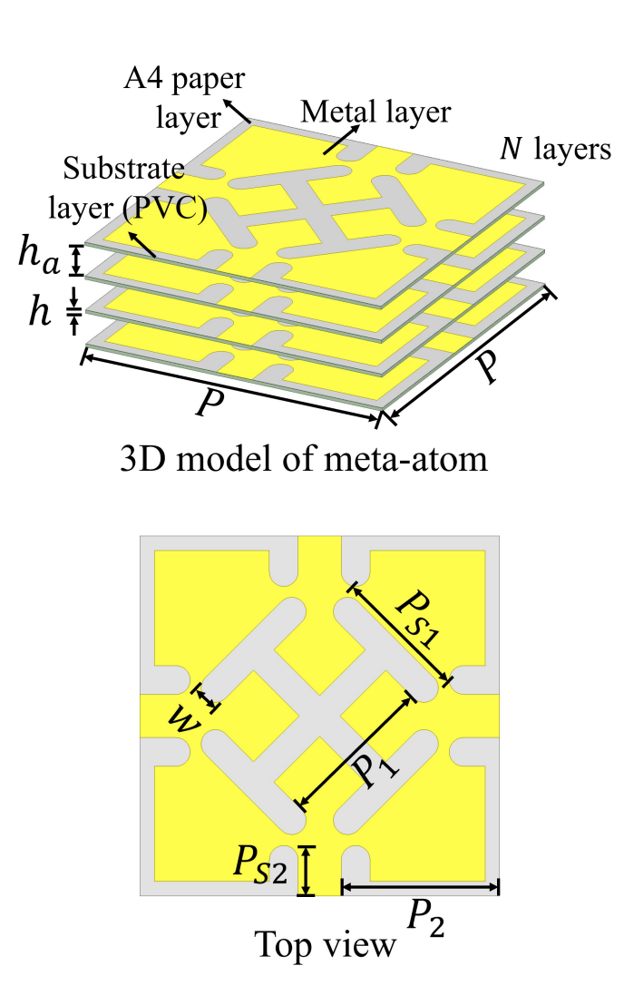
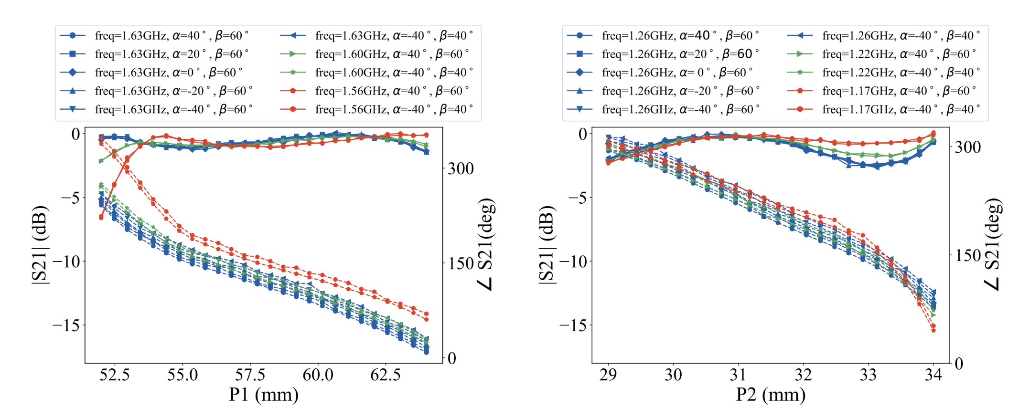
Microscopic: Meta-atom design for GNSS
Meta-atom structure
~ L1 band performance
~ L2&L5 band performance
Notes:
This is our proposed design of a metasurface unit for application in multiple frequency bands of GNSS systems, such as the L1 L2 and L5 bands, with high transmittance and phase modulation capability of more than 300 degrees.

Slide 20
GNSS-based Indoor Positioning
$$S_{2}$$
$$S_{2}$$
$$S_{3}$$
$$S_{3}$$
$$S_{1}$$
$$S_{1}$$
$$R(S_{2},M_{2})$$
$$R(S_{3},M_{2})$$
$$R(S_{2},M_{2})$$
$$R(S_{3},M_{2})$$
$$R(S_{1},M_{1})$$
$${window}_{2}$$
$${window}_{2}$$
$${window}_{1}$$
$${window}_{1}$$
GNSS treats $R\left(S_{1},M_{1}\right)$as the direct path
$$PR\left(S_{1},user \right)=R\left(S_{1}, window\right)+$$
$R(window, user)$
$$user$$
$$user$$
Positioning error is too large,
e.g., 10-80 meters
Notes:
For the second challenges, we first consider the case where the signal is introduced into the room only through a window. When an indoor user decodes out a GNSS signal, the transmission path through which the signal travels is actually from the satellite to the window and then from the window to the user. Moreover, the distance from the window to the user is difficult to be calculated accurately because of various reflections of the incident signals. If the existing GNSS positioning algorithm is used to locate the indoor user, [CLICK] GNSS will ignore the window and treat the calculated path as a direct path from the satellite to the user. So, this is why the positioning error is very poor in indoor scenarios, [CLICK] which can hit 10 to 80 meters.

Slide 21
GNSS-based Indoor Positioning with Metasurfaces
$$S_{2}$$
$$S_{1}$$
$$S_{3}$$
$$R(S_{2},M_{2})$$
$$M_{2}$$
$$R(S_{3},M_{2})$$
$$M_{1}$$
$$R(S_{1},M_{1})$$
$$M_{2}$$
$$M_{1}$$
same length
$$user$$
$$PR\left(S_{1},M_{1}\right)=R\left(S_{1},M_{1}\right)+$$
$D(M_{1}, user)$
$$user$$
Notes:
So, if we take the metasurface into account, the GNSS signals received by the user also go through two paths from the satellite to the metasurface and then from the metasurface to the user. The second path, because of the steering of the metasurface, ensures that it minimizes the uncertainties caused by reflections and other multi-path factors.
[CLICK] Moreover, we observe that different satellites may pass through the same metasurface to forward signals to the user, so we can implement an algorithm based on this to calculate the distance from metasurfaces 1 and 2 to the user, [CLICK] and then further derive the user's coordinates (x, y); here, for simplicity, we ignore the z-axis information.

Slide 22
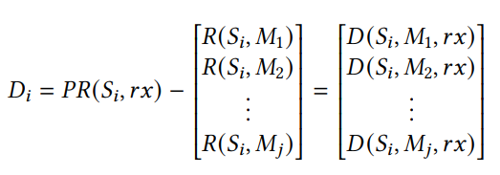
GNSS-based Indoor Positioning Alg. with Metasurfaces
$$S_{2}$$
Calculate pseudorange use ephemeris
$$S_{1}$$
$$S_{3}$$
$$R(S_{2},M_{2})$$
Calculate residual pseudorange $D_{i}$ of all mts
$$R(S_{3},M_{2})$$
$$R(S_{1},M_{1})$$
Remove remaining residual pseudorange of new matched signal path
$$M_{2}$$
Find a minimal matching residual pseudorange
$$M_{1}$$
same length
All signal paths matched?
No
Yes
End
Notes:
We designed indoor GNSS localization algorithms that are compatible with metasurface, and the whole algorithm is based on GNSS raw data without any other additional information.

Slide 23
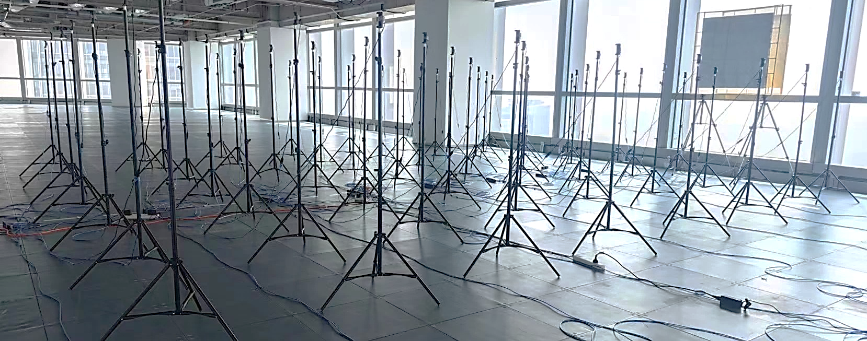
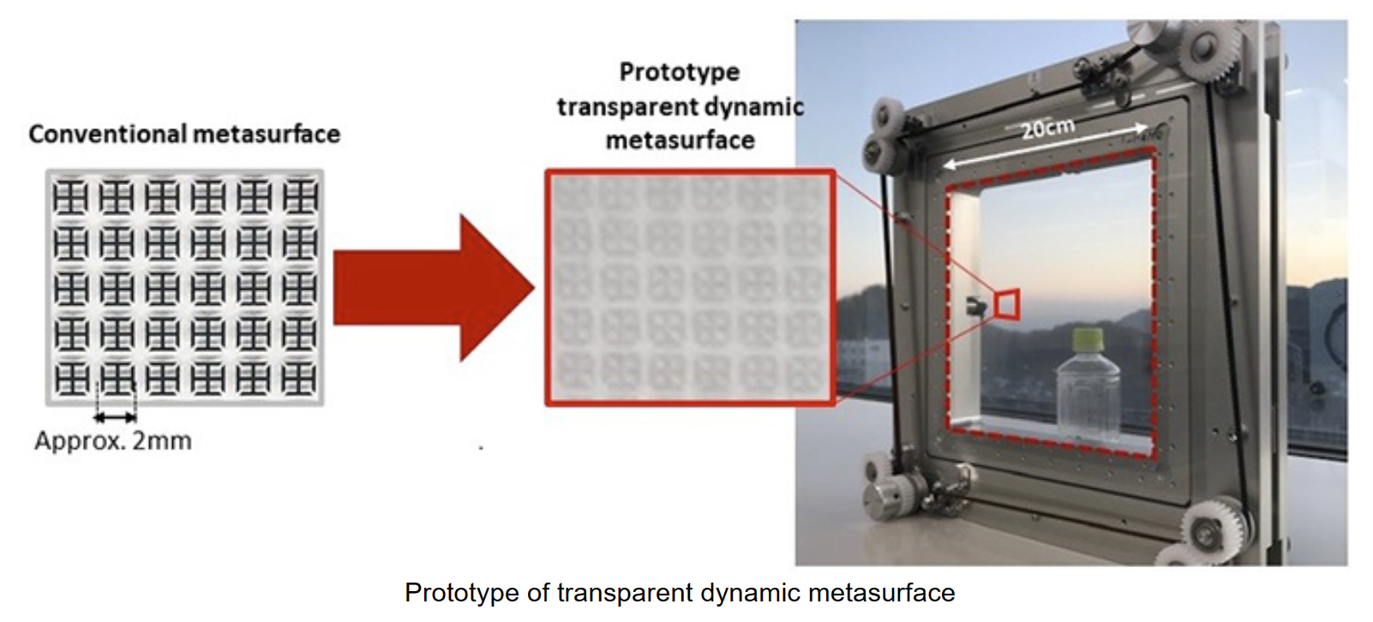
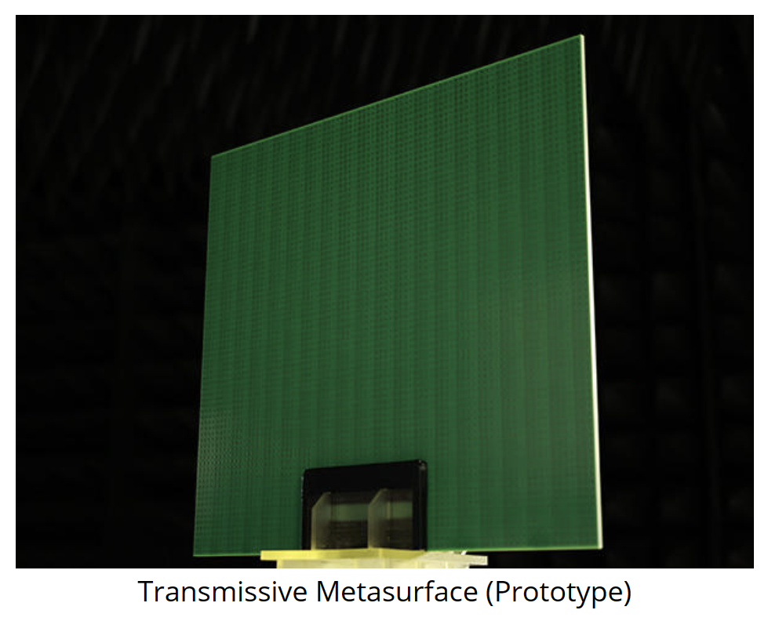
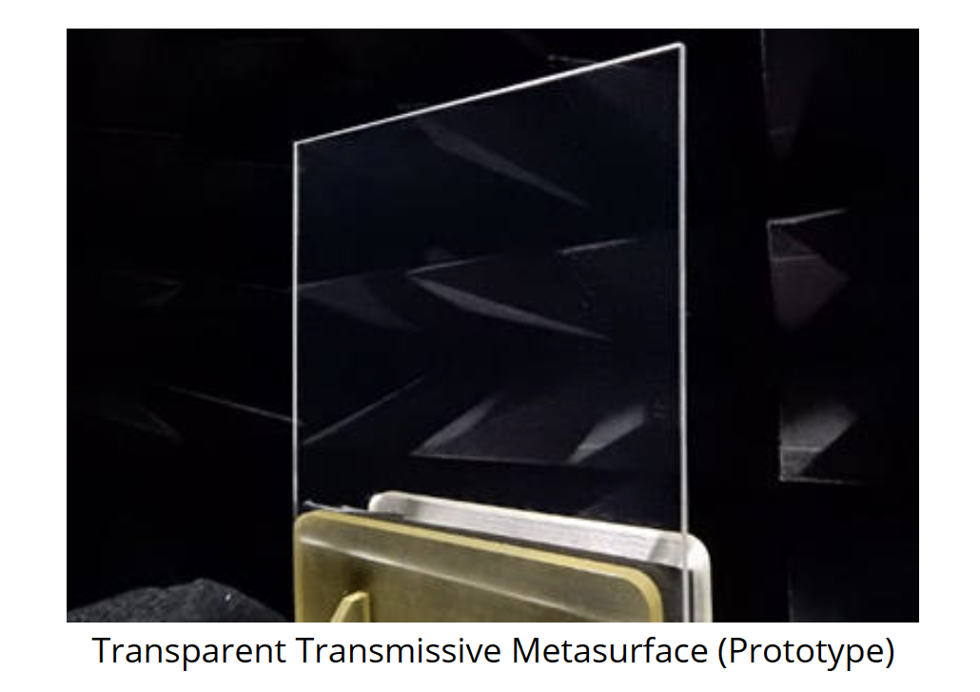
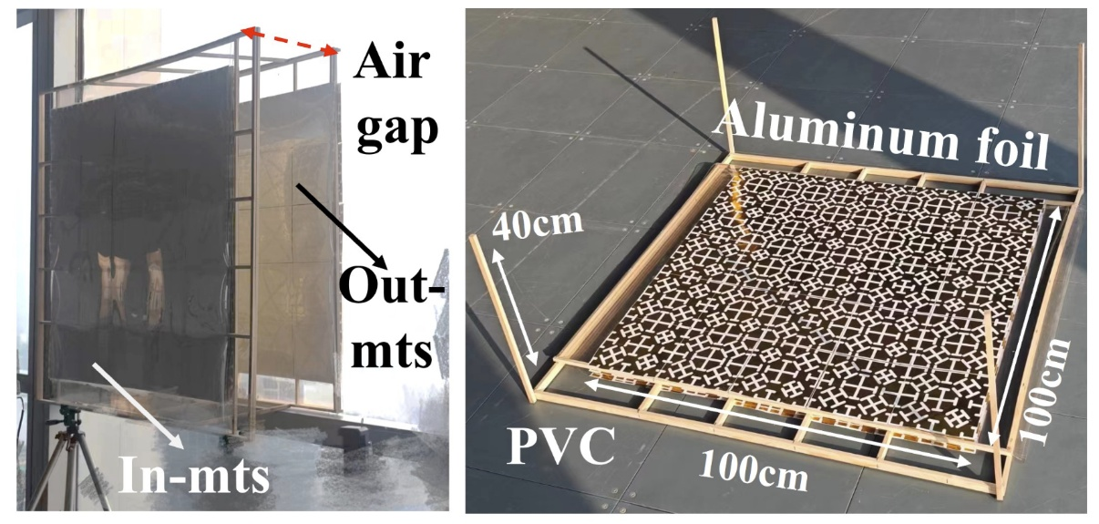
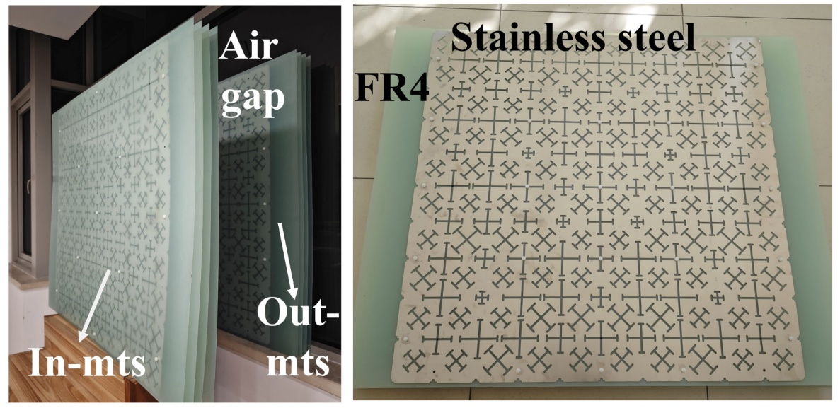
Experiment Setup and Metasurface Fabrication
GNSS metasurface
deployment
$7×8$
GPS sensors
Metasurface fabrication
https://global.kyocera.com/newsroom/news/2022/000526.html
https://www.docomo.ne.jp/english/info/media_center/pr/2020/0117_00.html
Notes:
We fabricated the metasurface and deployed it on a window to prototype our proposed system. [CLICK] The metasurface is made up of two sub-metasurfaces, each sub-metasurface can be fabricated by different materials, we list two prototypes here: left is processed through A4 paper and plastic sheets, and hot stamping methods. And the right is processed by the PCB technology.
Of course, we can also use some transparent conductive materials to make a transparent metasurface so that its light transmission will not be affected when deployed on a window. These are some transparent metasurface cases [CLICK]. this is from a Japanese docomo company's products, [CLICK] this is also a Japanese company called kyocera's products.

Slide 24
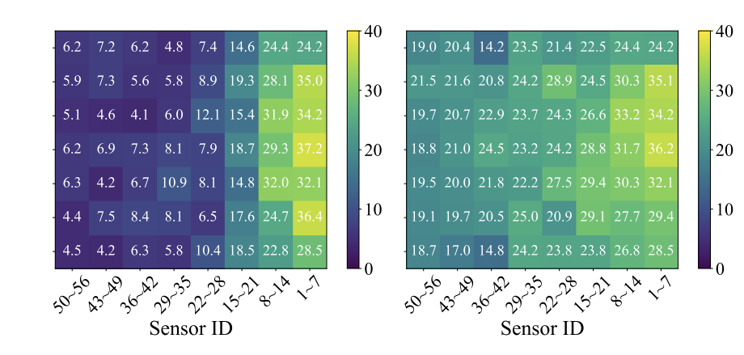
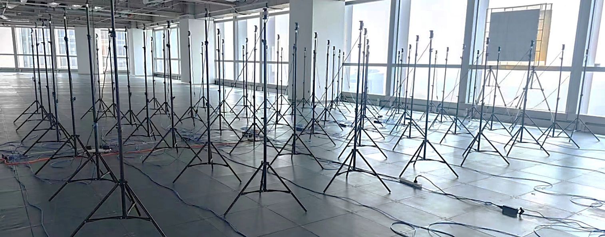
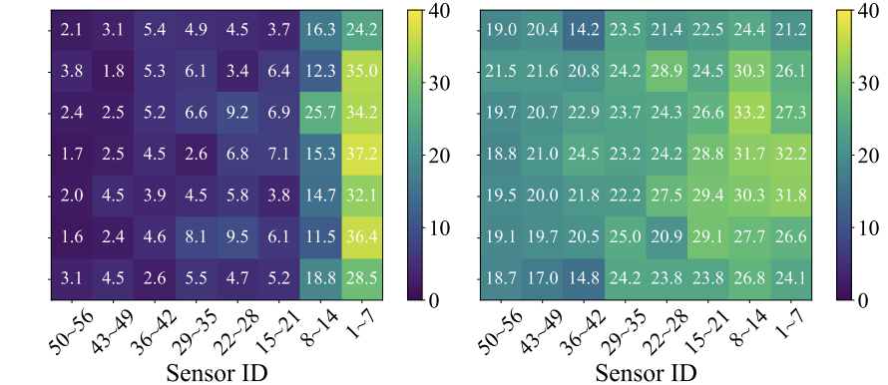
Metasurface performance on indoor coverage
Comparison of the SNR of received GNSS satellites
SNR of visible GNSS satellites
9.1dB -> 23.2dB
$7×8$
GNSS sensors
Comparison of the number of in-use GNSS satellites
# of in-use GNSS satellites
3.6 -> 21.5
Notes:
We are still using a 7x8 array of GNSS sensors to evaluate the performance of the metasurface. We found that with the addition of metasurface, we can increase the SNR of the indoor satellite signal from [CLICK] 6.4dB to 21.3dB, [CLICK] and increase the number of GNSS satellites available for positioning from [CLICK] 3.6 to 21.5.

Slide 25
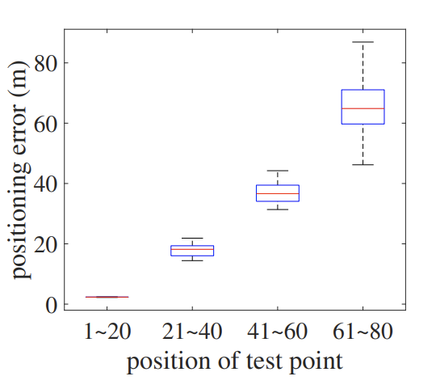
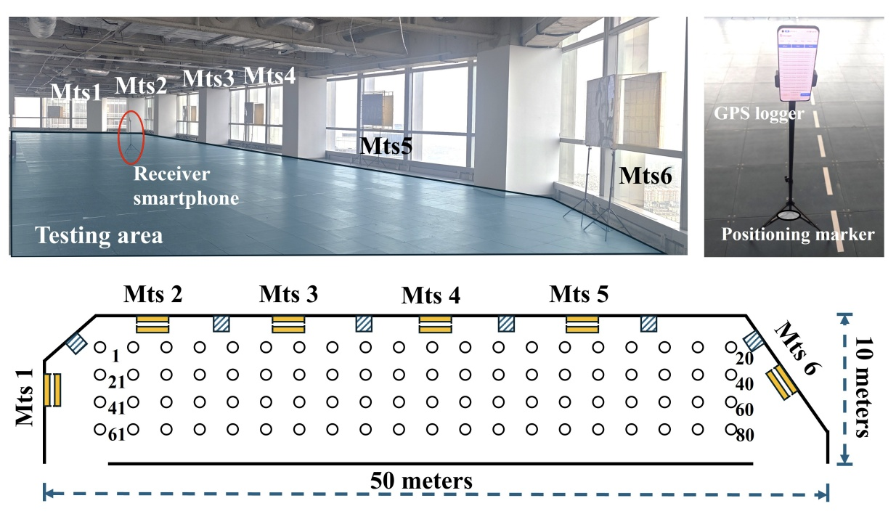
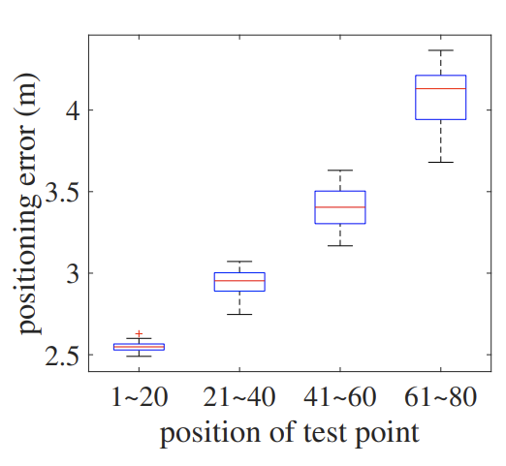
Indoor positioning performance
w/o mts
Average absolute positioning error:
30.6 meters
w/ mts
Average absolute positioning error:
3.2 meters
Notes:
We also used a cell phone to record GNSS raw data and perform validation of the positioning algorithm. [CLICK] Before adding the metasurface, our localization accuracy was 30.6 meters on average in an indoor scene. [CLICK] After adding metasurface, its positioning accuracy can hit [CLICK] 3.2 meters. This fully validates the feasibility of our proposed system.

Slide 26
MobiCom 2024
Thanks for listening!
Notes:
The above is all my presentation. Thanks for listening!

Slide 27
Our solution and advantages
Step1: Focus signals against wall attenuation
Step2: Spreading EM waves to cover the entire space
step2
step1
GPS signal
-125dBm
Metasurface (10dB gain)
Wall attenuation :
-10 dB
Metasurface can focus the GPS signals
Metasurface do not introduce delay, no need for clock synchronization
Metasurface is passive, without power supply
Metasurface is cheap, can be fabricated with Al foil and PVC
Indoor: -125dBm
Notes:
Our solution involves using a metasurface to enhance GPS signal reception. It is a passive system capable of providing approximately 10 dB of gain. The metasurface can be placed outdoors. After the wall introduce a 10 dB signal attenuation, the signal can still have enough signal strength to be decoded by the indoor receiver.
Additionally, metasurfaces can introduce phase delays, and we can use this phase information to identify different metasurfaces.

Slide 28
Through wall
Basic wall
interface mortar layer
insulation layer
Mesh cloth
Mortar

