Slide 1







© MobiCom 2025
Hong Kong, China
WDNN: Weighted Diffractive Neural Network for Physical-layer RF Signal Processing
Yezhou Wang, Yongjian Fu, Hao Pan, Qinyn Hu,
Lili Qiu, Yi-Chao Chen, Guangtao Xue, Ju Ren
Notes:
Thank you to the session chair for the introduction. Hello everyone, I am Yezhou Wang from Shanghai Jiao Tong University. I will present our work entitled "WDNN: Weighted Diffractive Neural Network for Physical-layer RF Signal Processing." This research focuses on achieving efficient neural network-based signal processing at the physical layer.

Slide 2
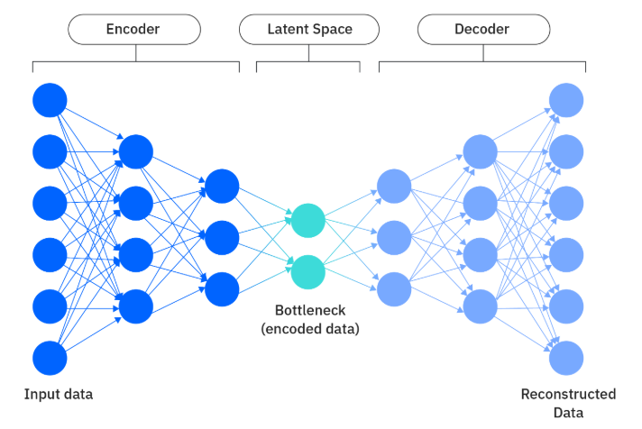
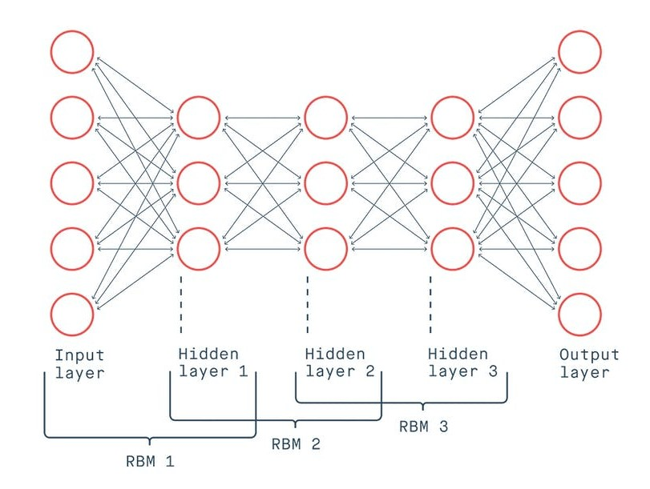
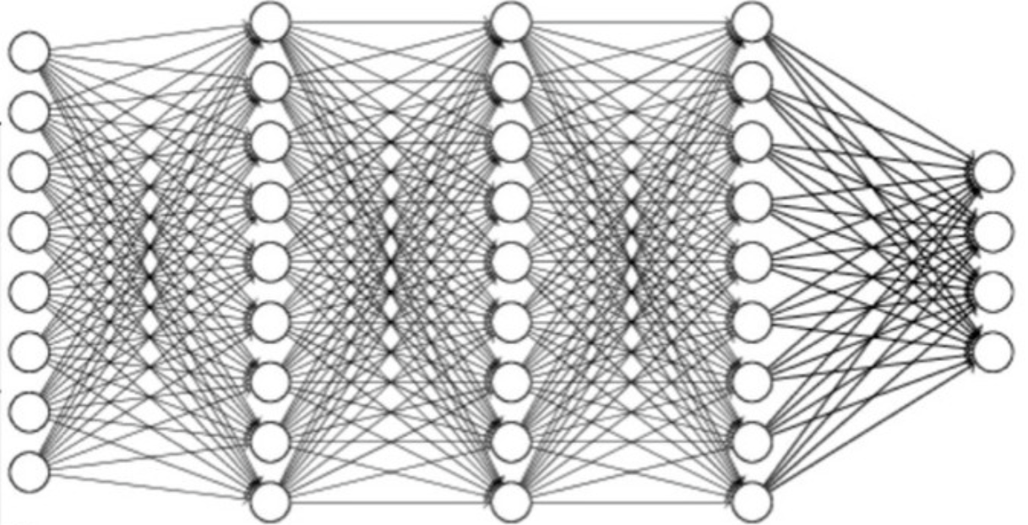











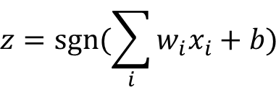
Neural Network and Neuronal Computation
Neural Network
Neuron and Neuronal Computation
$$1$$
$$x_{1}$$
$$w_{1}$$
$$b$$
Input
layer
Output
layer
$$x_{2}$$
$$y$$
$$z$$
$$w_{2}$$
$$∑$$
sgn
$$w_{3}$$
$$x_{3}$$
$$z=sgn⁡(\sum_{i}{w_{i}x_{i}}+b)$$
…
Hidden layers
Deep Neural Network (DNN)
Variational AutoEncoder (VAE)
Deep Belief Network (DBN)
Notes:
First, let's briefly review the basic structure of neural networks. A neural network is typically composed of an input layer, several hidden layers, and an output layer. Each layer performs a linear transformation on its input through weights (W) and biases (b), and introduces nonlinearity via activation functions such as Sigmoid or ReLU.
【click】Common architectures like Deep Neural Networks (DNN), Variational Autoencoders (VAE), and Deep Belief Networks (DBN) leverage these mechanisms to achieve complex function approximation and feature extraction.
However, most of these neural networks run on digital computing platforms, which suffer from high power consumption and latency. This makes it challenging to meet the requirements for real-time performance and energy efficiency, especially in edge computing and IoT scenarios.

Slide 3
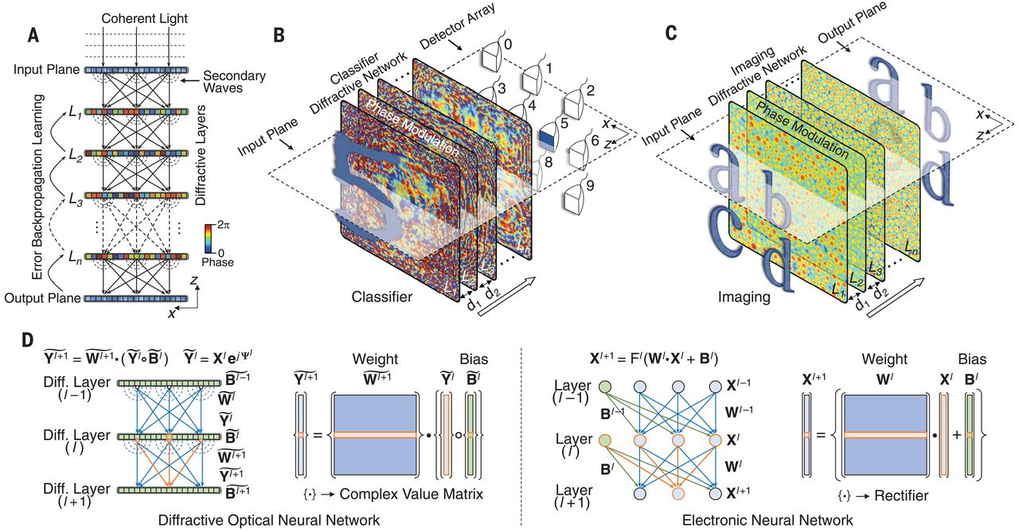
Diffractive Neural Network
[1] All-optical machine learning using diffractive deep neural networks. Science 2018.
Notes:
To address the challenges mentioned above, Diffractive Neural Networks (DNNs) have been proposed in recent years. DNNs are all-optical neural networks that perform matrix operations through light diffraction, eliminating the need for electronic computation.
As illustrated in the figure, input optical signals propagate through multiple metasurface layers, with each layer analogous to a layer in a neural network. In this architecture, the phase and amplitude of light correspond to the weights and biases in traditional networks, and the final classification result is formed on the output plane.
This approach offers advantages such as ultra-low power consumption and exceptional parallelism, making it a promising direction for physical-layer AI.

Slide 4
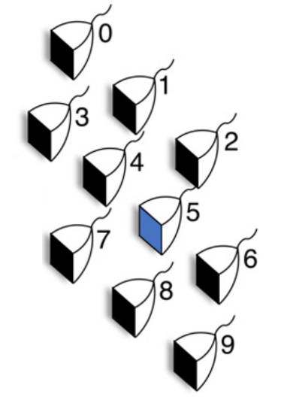
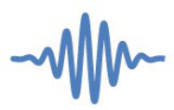

















Metasurface-based Diffractive Neural Network
$$1$$
$$x_{1}$$
$$w_{1}$$
$$b$$
Input
layer
Output
layer
$$x_{2}$$
$$w_{2}$$
$$y$$
$$z$$
$$∑$$
sgn
$$x_{3}$$
$$w_{3}$$
…
$$z=sgn⁡(\sum_{i}{w_{i}x_{i}}+b)$$
Hidden layers
(Propagation zones)
Meta-atom
Diffracted waves
Detector array
(i.e., antenna)
Diffraction zones
…
…
…
$$w_{1}$$
Incident signals
Incident
waves
Secondary
wave
$$w_{2}$$
$$w_{3}$$
$$b$$
Meta-atom
…
Multi-layer
metasurface
Excitation
wave
Input
layer
Diffractive layers
Output
layer
Meta-atom
Notes:
In optical diffractive neural networks based on metasurfaces, the network structure consists of multiple diffraction zones, with each metasurface layer composed of numerous meta-atoms.
【click】When the incident electromagnetic wave propagates to each meta-atom, it can modulate the phase and amplitude of the incoming wave, generating secondary waves that are transmitted to the next layer.
【click】This operation is analogous to neurons and fully connected layers in digital neural networks.

Slide 5
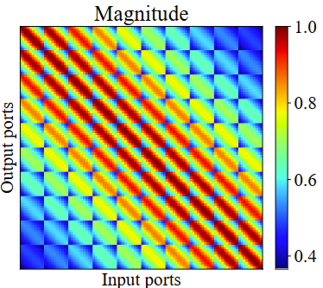
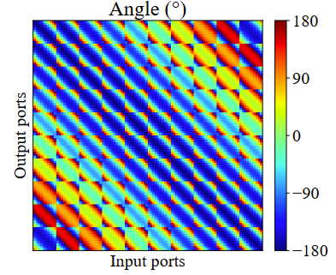




Propagation Weights of the Metasurface-based Diffractive NN
Meta-atom
Diffracted waves
Detector array
(i.e., antenna)
Multi-layer
metasurface
…
…
…
$$w_{1}$$
Incident signals
Incident
waves
$$w_{2}$$
$$w_{3}$$
$$b$$
…
Input
layer
Diffractive layers
Output
layer
Propagation weight matrix
Diffraction Zones
Propagation weight matrix (complex value):
Amplitude between two units
Phase delay between two units
Distance of two units DETERMINE the weights
- Limited adjustment space
Notes:
Each meta-atom functions as a neuron, capable of applying amplitude attenuation and phase delay to each input.
【click】In diffractive neural networks, the propagation between layers can be modeled as a complex-valued matrix multiplication. Each meta-atom in the preceding layer is connected to every meta-atom in the next layer through propagation across air gaps, forming a fully connected layer. The connection weights between neurons are determined by the amplitude attenuation and phase delay induced by the propagation distance.
【click】Taking the MNIST dataset as an example, all connection weights together form the transmission weight matrix, while the stacked metasurfaces make up the complete neural network. The incident waves travel through multiple network layers and reach the detector array in the final layer. The neuron with the highest intensity directly outputs the classification result.
【click】Here is a visualization of how each transmission matrix modifies the amplitude and phase during propagation.
【click】However, since the transmission matrix between metasurfaces is determined by the air gap between layers, this approach suffers from limited adjustment space, restricting flexibility in optimizing the network architecture and performance.

Slide 6
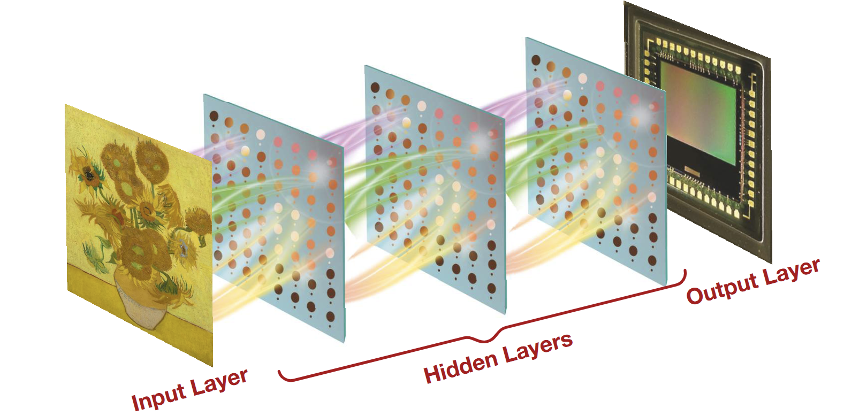
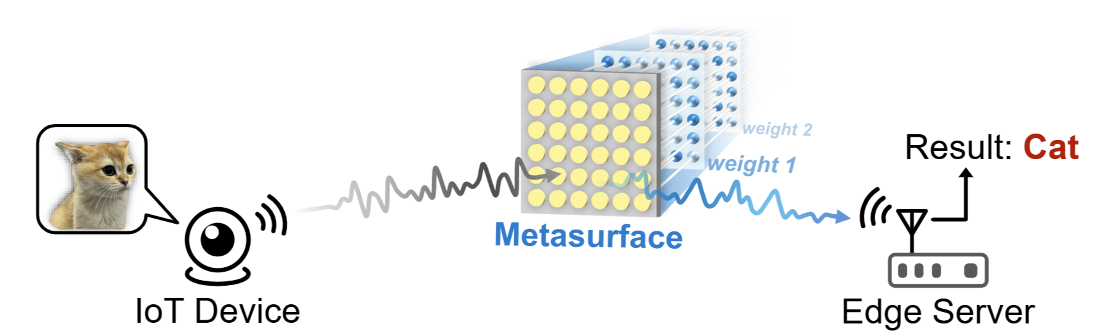
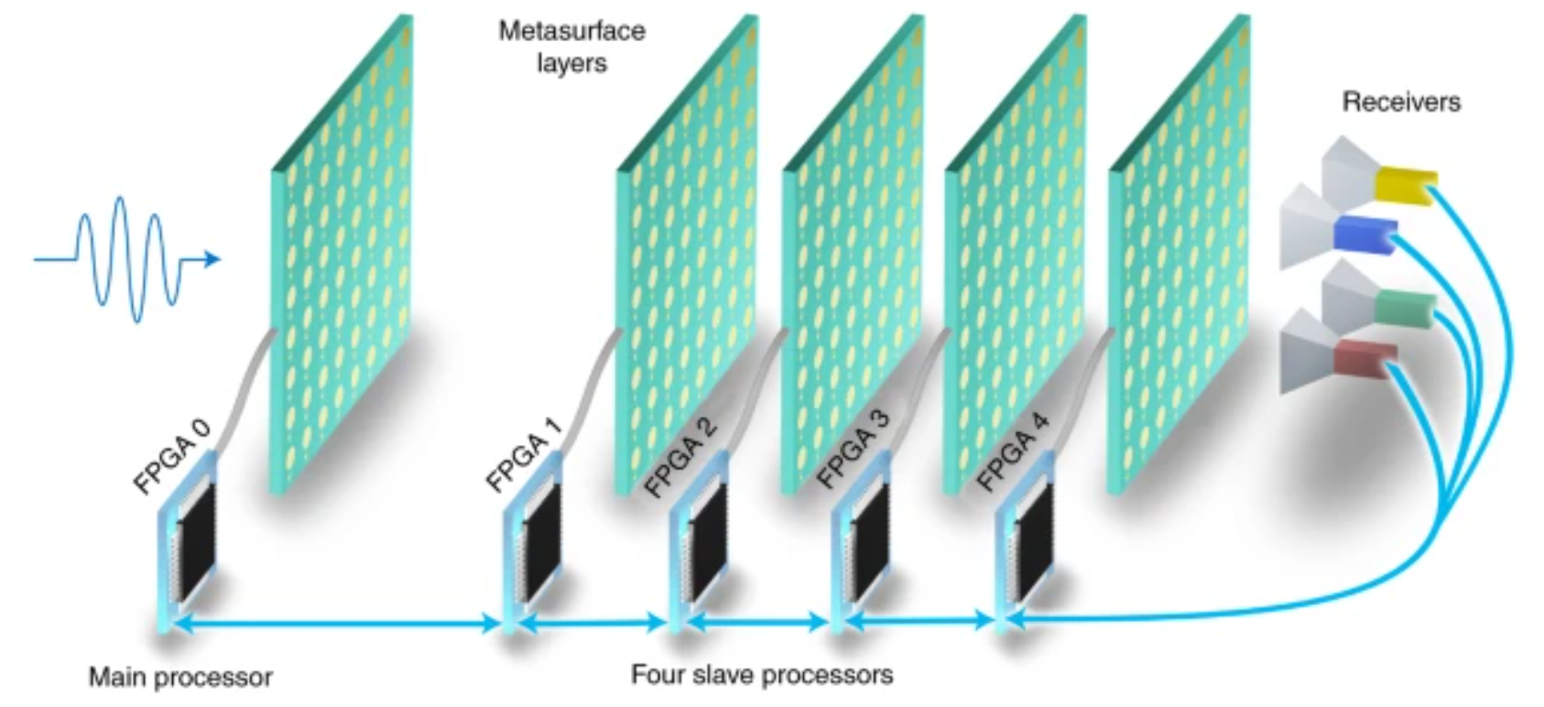
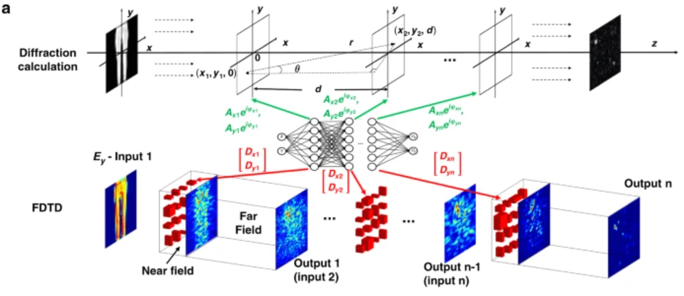
Existing Works Based on Physical Diffractive NN
[1] Binary Optical Machine Learning: Million-Scale Physical Neural Networks with Nano Neurons. ACM MobiCom 2024.
[2] Enabling Over-the-Air AI for Edge Computing via Metasurface-Driven Physical Neural Networks. ACM SIGCOMM 2025.
[3] A programmable diffractive deep neural network based on a digital-coding metasurface array. Nature Electronics 2022.
[4] Metasurface-enabled on-chip multiplexed diffractive neural networks in the visible. Nature light: science & applications 2022.
Notes:
Currently, various implementations of diffractive neural networks based on metasurfaces and RF circuits have been developed. For example:
• [1] Utilizing nanoscale metasurfaces to construct optical neural networks with millions of neurons;
• [2] Achieving airborne AI inference by employing programmable metasurface arrays;
• [3] Realizing on-chip multiplexed diffractive neural networks in the visible light spectrum;
• [4] Employing terahertz spoof plasmonic structures for information recognition.

Slide 7
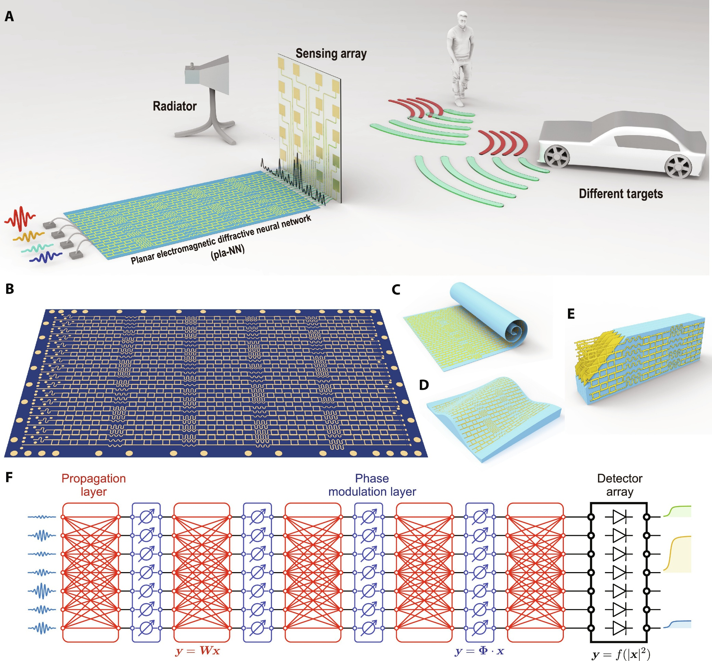
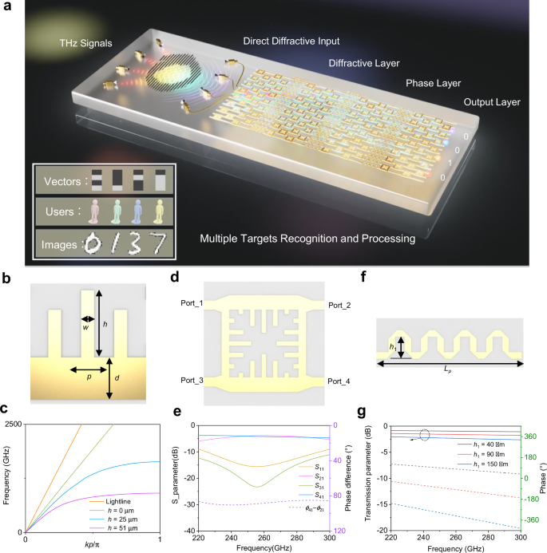
Metasurface -> RF Circuit (Plane Diffractive NN)
[1] Direct electromagnetic information processing with planar diffractive neural network. Science Advances 2024
[2] Terahertz spoof plasmonic neural network for diffractive information recognition and processing. Nature Communication 2024
Notes:
In addition to optical implementations, RF circuits have also been employed to build diffractive neural networks in recent years. As shown in the figure, the input RF signal enters the propagation module (such as a coupler network) via an antenna array. Weight adjustment is achieved through phase shifters, and the output result can be obtained using power detectors.

Slide 8

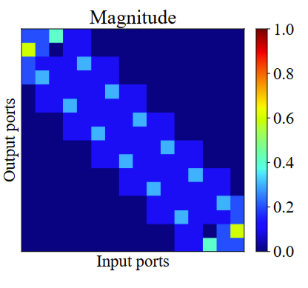
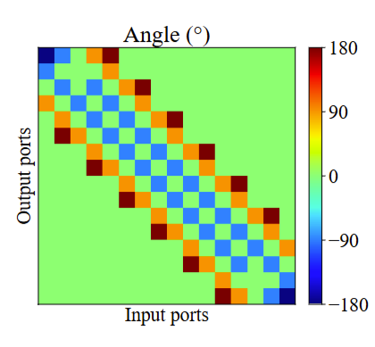
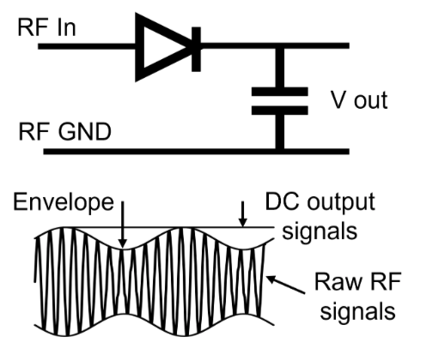



RF Circuit-based Diffractive NN
Input layer
Hidden layers
Output layer
$$W_{i}$$
$$B_{i}$$
$$W_{i+1}$$
…
Propagation weight matrix
Incident signals
Output DC signals
…
…
…
…
…
…
…
…
Antenna
Propagation module:
RF coupler network
Bias module:
Phase shifters
Output module
Port 1
Port 2
Power Detector
RF Coupler
Module
Port 4
Port 3
RF Phase
Delay Line
Port 1
Port 2
Notes:
Let’s take a closer look at the implementation of each layer in RF circuit-based diffractive neural networks.
【click】Firstly, the diffraction matrix, which corresponds to the air gap in optical neural networks, is realized using RF coupler units in the RF circuits.
【click】When visualizing the weight matrix, it still displays a symmetric structure.
【click】Next, the portion responsible for adjustable neuron weights is implemented by phase shifter units, serving as the bias module.
【click】Finally, the output layer uses power detectors to measure the signal strength, and the signal with the highest intensity is directly taken as the final output

Slide 9

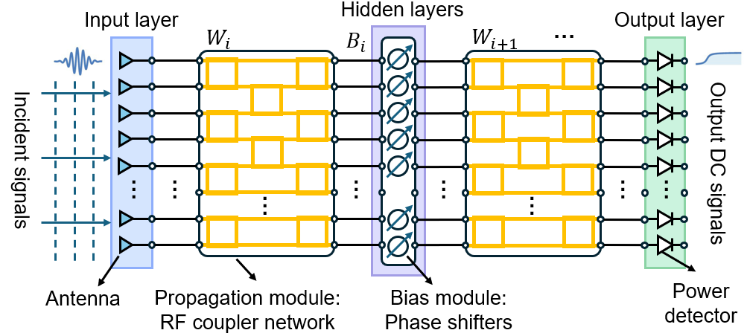

How to Build a Diffractive NN as a Digital NN?
Existing metasurface-based Diffractive NN:
- Limited adjustments of weights
- No non-linear activation
Existing RF circuit-based Diffractive NN:
- Limited adjustments of weights
- Not support complex value bias
- No non-linear activation
Detector array
(i.e., antenna)
Diffraction zones
Incident
waves
Secondary
wave
Meta-atom
Multi-layer
metasurface
Excitation
wave
Meta
-atom
How to design a physical diffractive NN that meets the following criteria:
Fully connected layers;
Freely adjustable weights and biases (with complex values);
Incorporation of nonlinear activation functions.
Notes:
Combining existing optical and RF circuit-based diffractive neural network solutions, several key challenges remain:
• Limited range of weight adjustment; • Lack of support for complex-valued bias; • Absence of nonlinear activation.
This raises a fundamental question: How can we design a physical diffractive neural network that achieves fully connected structure, provides independent and flexible adjustment of complex weights and biases, and supports nonlinear activation?
【click】Our aim is to build a truly "learnable" physical network.
In other words, we envision a system that possesses three essential capabilities:
Support for fully connected propagation structures;
Independent and continuous control over every weight and bias, including complex-valued weights;
Implementation of nonlinear activation, enabling stronger representation and fitting ability.
These three attributes are the foundation of the power behind digital neural networks.
Our goal is to realize all of them at the RF hardware level.

Slide 10
Our Solution: Design a novel RF circuit-based Diffractive NN
Input layers
Our contributions involve reconstructing these three modules
Hidden layers
Propagation modules
Activation modules
Bias modules
Output layers
…
…
…
…
…
…
…
Incident signals
Output DC signals
…
…
…
…
…
Notes:
Therefore, we propose WDNN—the Weighted Diffractive Neural Network.
WDNN consists of three core modules: the Propagation Module, the Bias Module, and the Activation Module.
The Propagation Module enables flexible adjustment of complex weights; the Bias Module controls the complex bias for each neuron; and the Activation Module introduces nonlinear responses.
The integration of these three modules endows WDNN with the full neural network functionality—all realized entirely through analog RF circuits

Slide 11
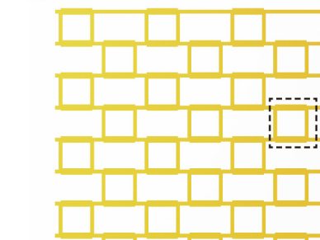
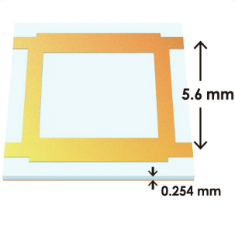


















































Propagation Modules: Full-connection, Free Weight Adjustment
$$W$$
RF Coupler Stacked Network
…
RF Coupler Unit
Physically implement
a propagation module
…
$${out}_{1}^{1}$$
$${out}_{1}^{2}$$
…
…
$${in}_{1}$$
$${out}_{1}$$
$$p_{1,1}$$
$${out}_{2}^{1}$$
$${out}_{2}^{2}$$
$$p_{k,1}$$
$$p_{N,1}$$
$${in}_{2}$$
$${out}_{2}$$
RF Coupler
$${in}_{3}$$
$${out}_{3}^{1}$$
$${out}_{3}^{2}$$
$$p_{k,2}$$
$${out}_{3}$$
Port 1
(${in}_{1}$)
Port 2
(${out}_{1}$)
$${in}_{4}$$
$${out}_{4}^{1}$$
$${out}_{4}^{2}$$
$${out}_{4}$$
$${in}_{5}$$
$${out}_{5}^{1}$$
$${out}_{5}^{2}$$
$${out}_{5}$$
Port 4
(${in}_{2}$)
Port 3
(${out}_{2}$)
$${out}_{6}^{1}$$
$${out}_{6}^{2}$$
$$p_{k,j}$$
$${in}_{6}$$
…
…
…
…
…
$${out}_{6}$$
…
…
…
…
$${out}_{2M−1}^{1}$$
…
$${out}_{2M−1}^{2}$$
…
…
$${in}_{2M−1}$$
$${out}_{2M−1}$$
$${in}_{2M}$$
$${out}_{2M}^{1}$$
$${out}_{2M}^{2}$$
$$p_{k,M}$$
$$p_{N,M}$$
$${out}_{2M}$$
$$P_{1}$$
$$P_{2}$$
…
$$P_{k}$$
$$P_{k+1}$$
…
$$P_{N−1}$$
$$P_{N}$$
Notes:
Let’s first examine why conventional RF circuits cannot achieve fully connected and freely adjustable RF weights.
【click】In traditional RF circuits, the propagation module is typically composed of RF coupler units. In each layer, these couplers distribute the energy input from port1 and port4 to port2 and port3.

Slide 12
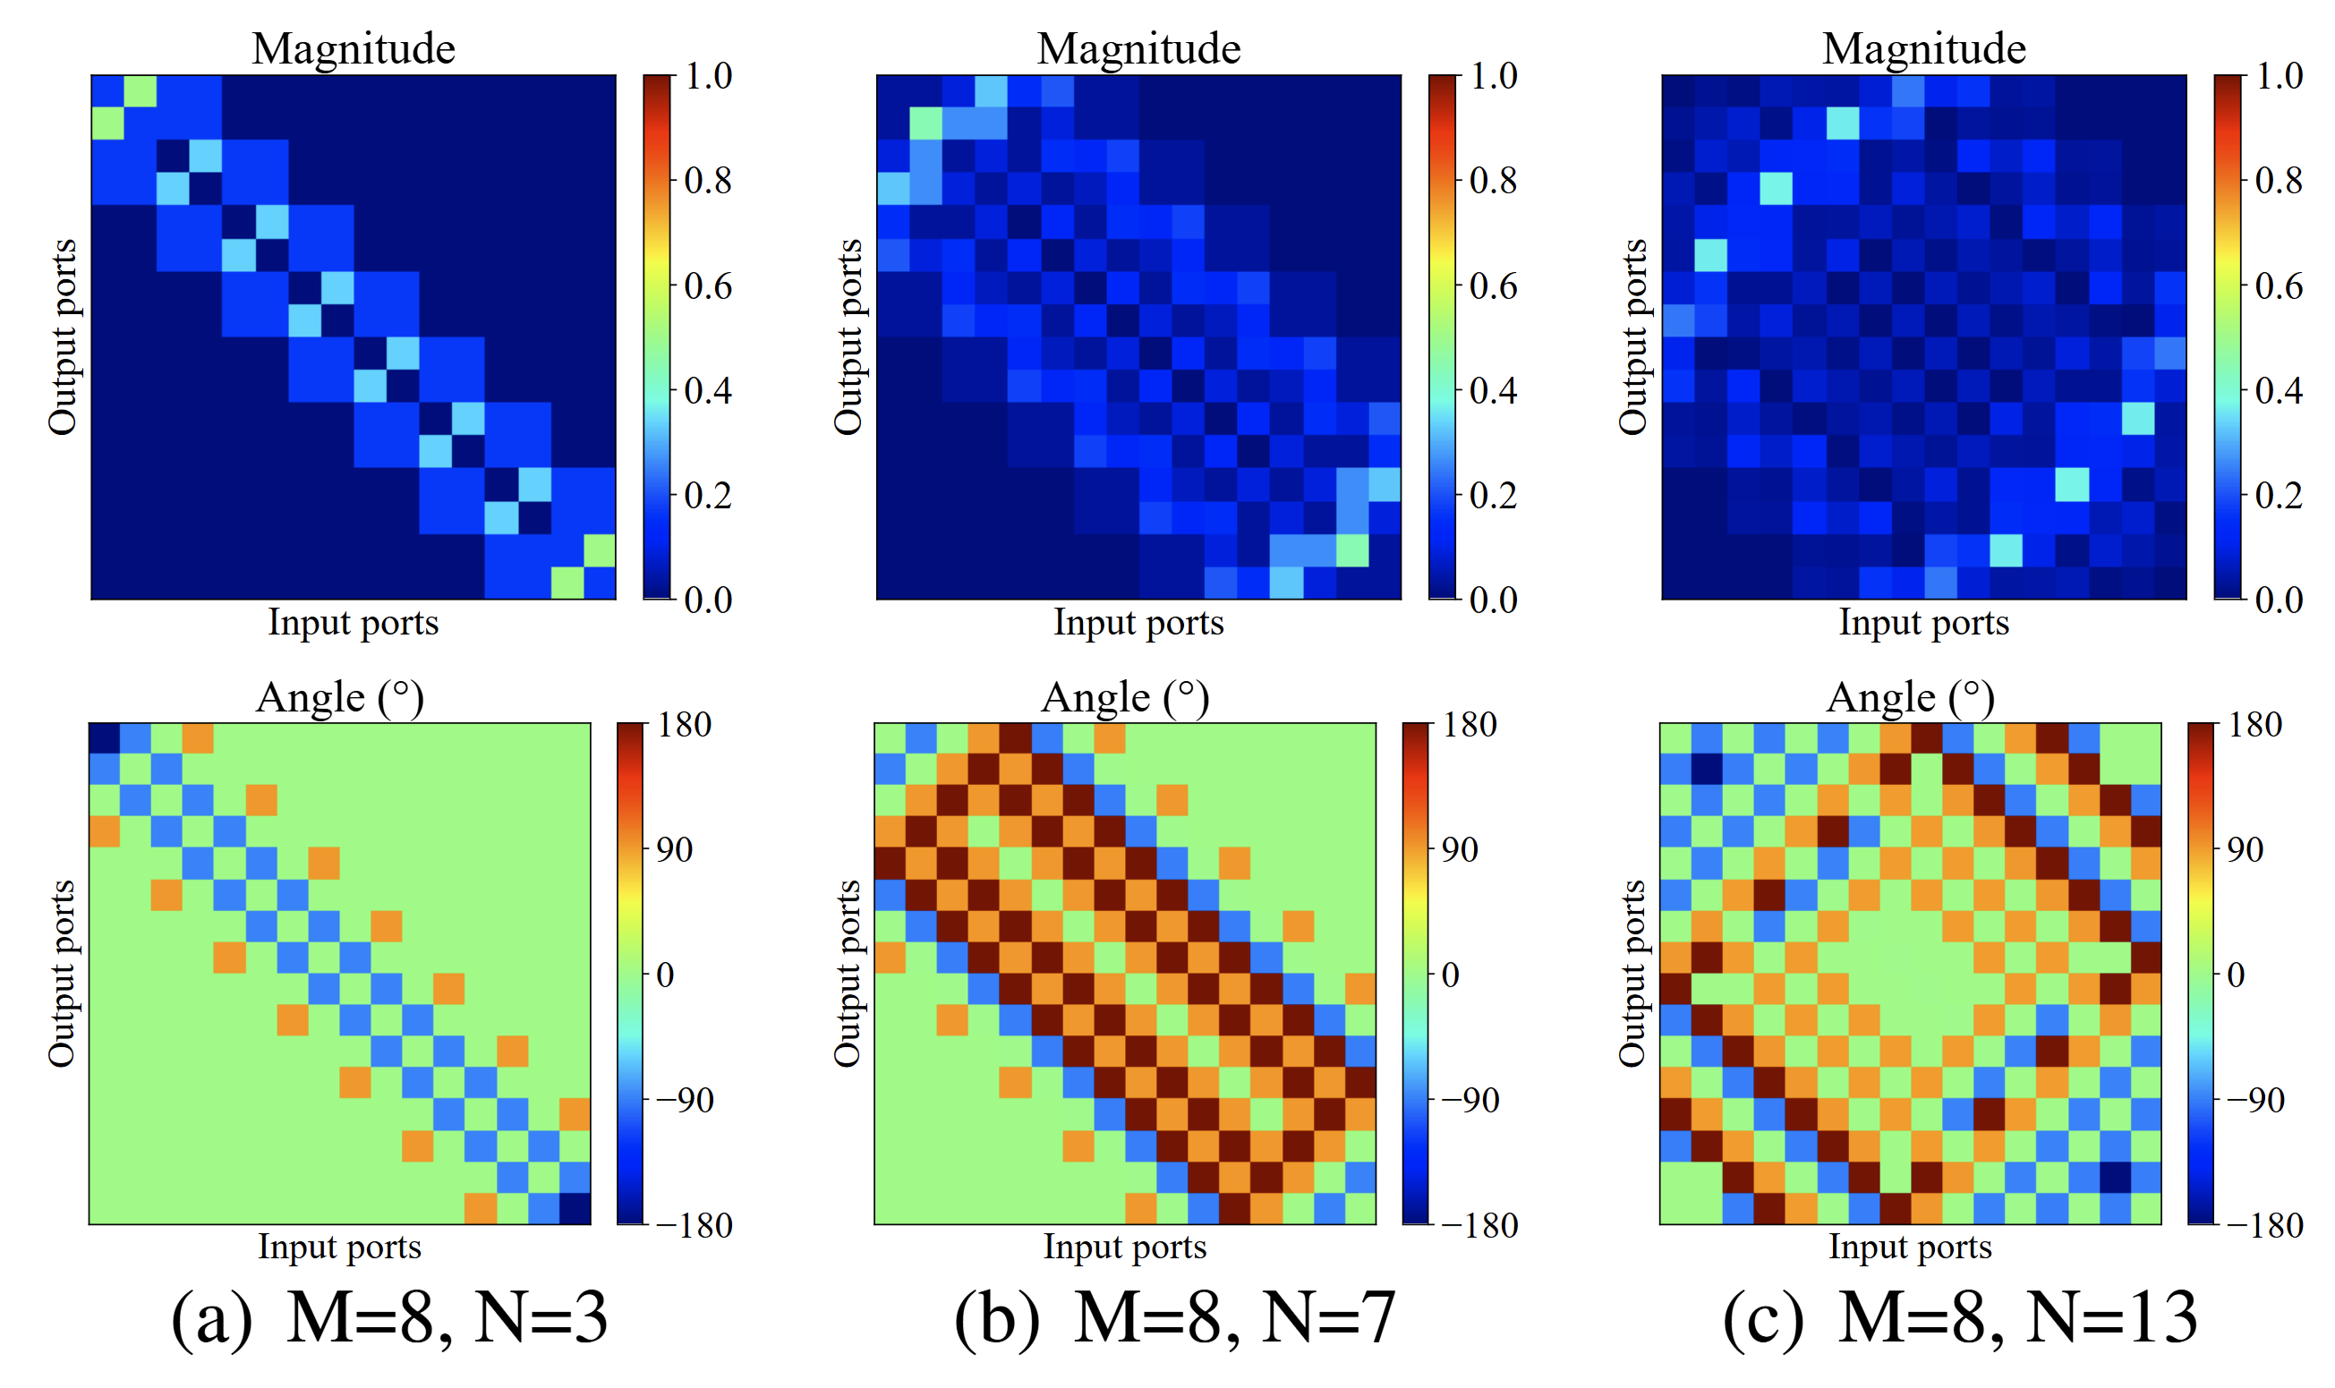
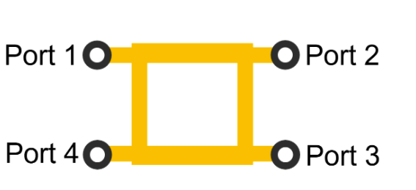
















































RF Coupler Unit
$${out}_{1}^{1}$$
$${out}_{1}^{2}$$
…
…
RF Coupler
$${in}_{1}$$
$${out}_{1}$$
Port 1
(${in}_{1}$)
Port 2
(${out}_{1}$)
$${in}_{2}$$
$$p_{1,1}$$
$${out}_{2}^{1}$$
$${out}_{2}^{2}$$
$$p_{k,1}$$
$$p_{N,1}$$
$${out}_{2}$$
$${in}_{3}$$
$${out}_{3}^{1}$$
$${out}_{3}^{2}$$
$${out}_{3}$$
Port 4
(${in}_{2}$)
Port 3
(${out}_{2}$)
$${in}_{4}$$
$${out}_{4}^{1}$$
$${out}_{4}^{2}$$
$$p_{k,2}$$
$${out}_{5}^{2}$$
$${out}_{4}$$
$${in}_{5}$$
$${out}_{5}^{1}$$
$${out}_{5}$$
$${in}_{6}$$
$${out}_{6}^{1}$$
$${out}_{6}^{2}$$
$$p_{k,j}$$
$${out}_{6}$$
…
…
…
…
…
…
…
…
…
…
$${in}_{2M−1}$$
$${out}_{2M−1}^{1}$$
…
$${out}_{2M−1}^{2}$$
…
$$p_{k,M}$$
$$p_{N,M}$$
$${out}_{2M−1}$$
$${in}_{2M}$$
$${out}_{2M}^{1}$$
$${out}_{2M}^{2}$$
$${out}_{2M}$$
$$P_{1}$$
$$P_{2}$$
…
$$P_{k}$$
$$P_{k+1}$$
…
$$P_{N−1}$$
$$P_{N}$$
Equal RF Coupler Network’s weights
- Limited adjustment space
Notes:
The -3dB couplers used in conventional circuits divide the input power equally between two output ports. This “symmetric coupling” maintains symmetry in the propagation matrix.
【click】Such a restriction results in an incomplete weight space for the network, preventing it from converging to complex mappings during training.
Therefore, we need to break this symmetric coupling relationship and construct a “non-uniform, tunable” propagation channel.

Slide 13

























We Propose a Novel Design: Weighted and Asymmetric RF Coupler
RF unequal power
splitter and combiner
RF unequal coupler
RF phase delay lines
$$W_{2}$$
$$L_{m2}$$
$$L_{c}$$
Port 1
RF in1
port 1
$$D_{l}$$
$$D_{m3}$$
$$D_{c1}$$
$$L_{2}$$
$$D_{1}$$
port 2
Port 2
RF out1
$$D_{m4}$$
$$R_{c}$$
$$D_{c2}$$
port 1
port 2
port 1
port 2
Isolation Resistors
$$S_{1}$$
$$D_{2}$$
$$D_{l}$$
$$D_{s1}$$
$$W_{1}$$
Port 4
RF in2
port 3
port 4
port 3
$$R_{s}$$
$$D_{l}$$
Port 3
RF out2
port 4
$$D_{s2}$$
$$D_{m2}$$
$$L_{3}$$
port 4
port 3
$$D_{l}$$
$$L_{s}$$
$$L_{m1}$$
$$S_{2}$$
Notes:
To address this, we propose a weighted asymmetric coupler.
Our circuit consists of three main components. The key idea is to use an unequal power splitter, a phase delay line, and an asymmetric combination to achieve arbitrary coupling ratios and flexible phase control.
It is important to note that if only an RF unequal coupler is used, the energy introduced from port1 will indeed be distributed unevenly between port2 and port3. However, due to symmetry, the energy distribution and phase changes between port1 and port4 will still be symmetric.
To overcome this, we employ Wilkinson power splitters and combiners to shift energy and break symmetry, while adjustable phase delay lines ensure phase alignment and minimize energy loss. Finally, the unequal power splitter enables arbitrary energy splitting ratios and precise phase control.

Slide 14
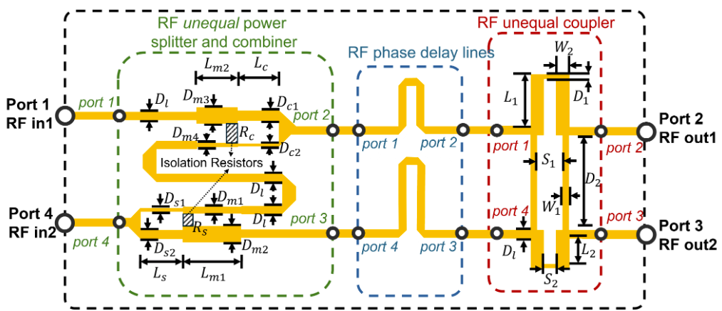
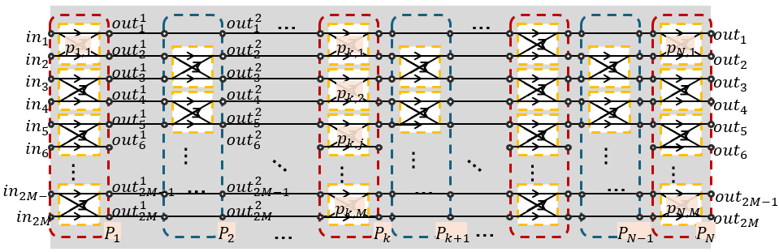
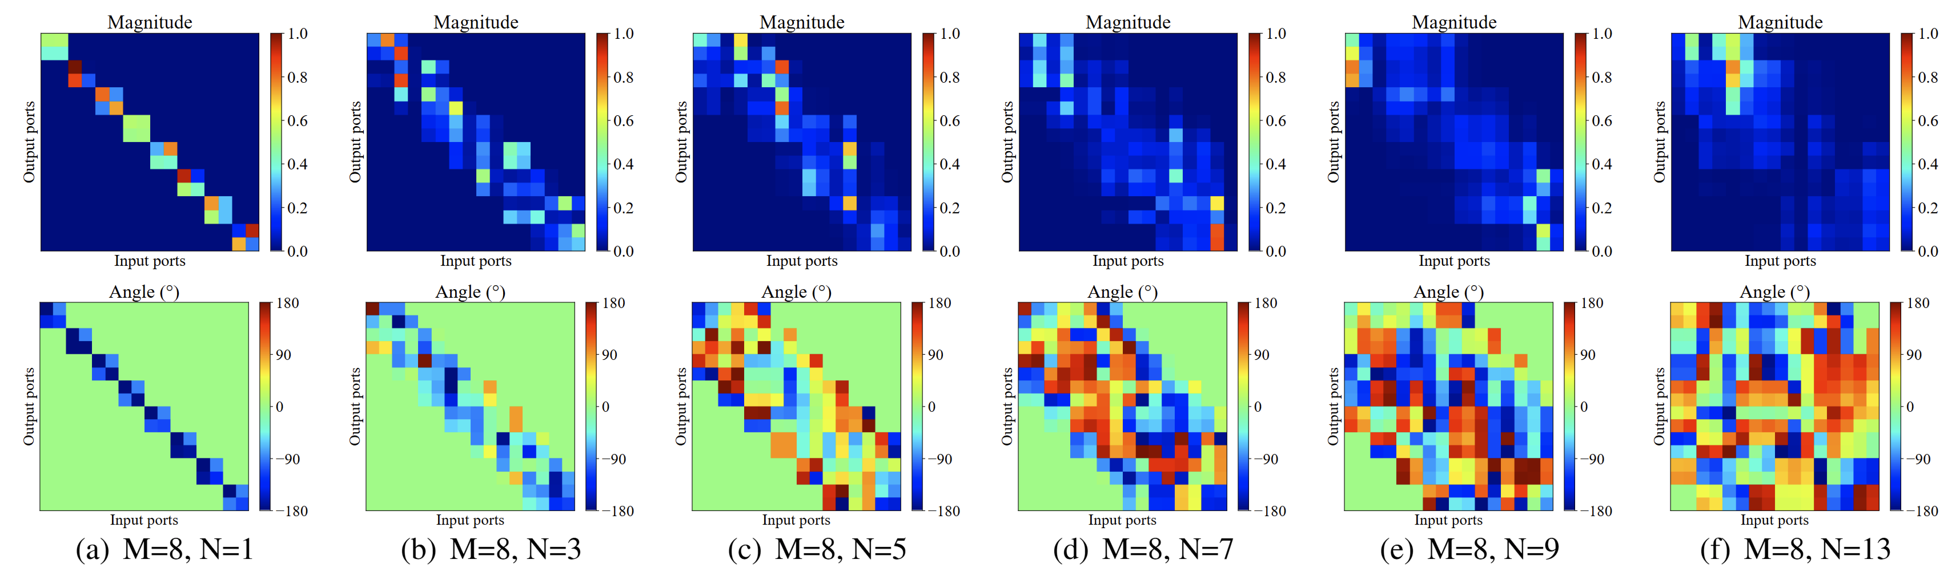
RF Coupler Network with Our Proposed Unit
Notes:
By adjusting these parameters, we can independently tune the complex weight (both amplitude and phase) of each connection channel between two layers of neurons.
This endows the entire propagation module with “fully adjustable matrix” capability.
Mathematically, this is equivalent to implementing a complex linear transformation layer. From an engineering perspective, it remains a purely analog RF network.
【click】By visualizing the amplitude and phase changes in the fully connected layer, we can see that the resulting transmission matrix breaks the previous symmetry and enables fitting of arbitrary energy matrices.

Slide 15
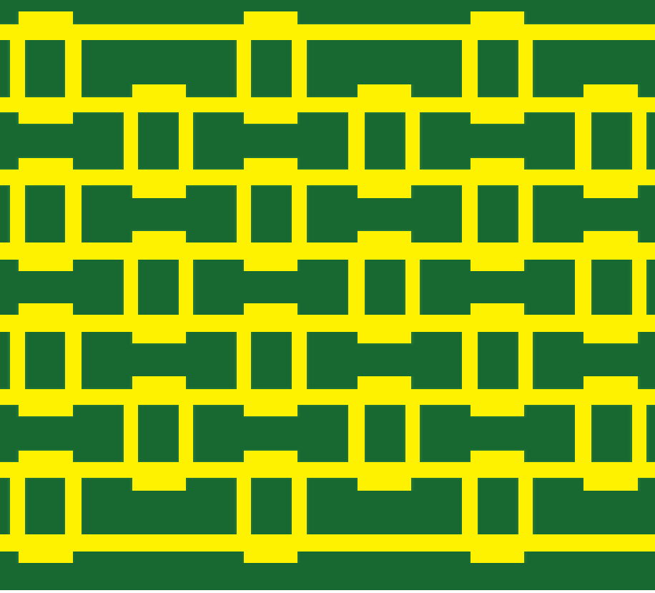

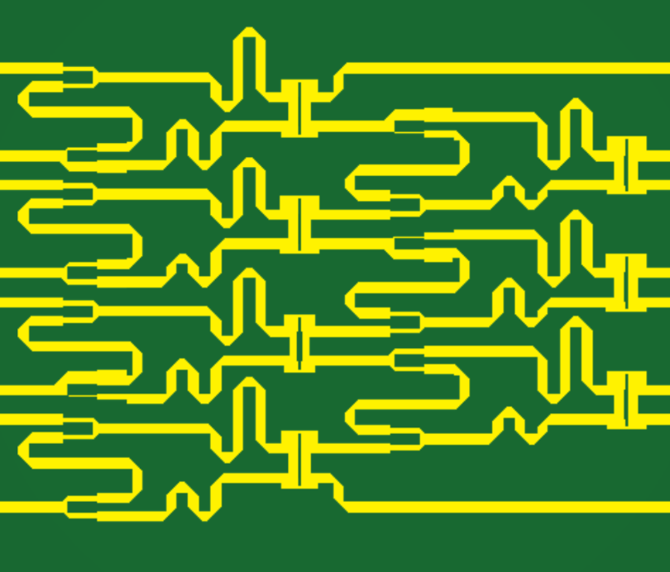
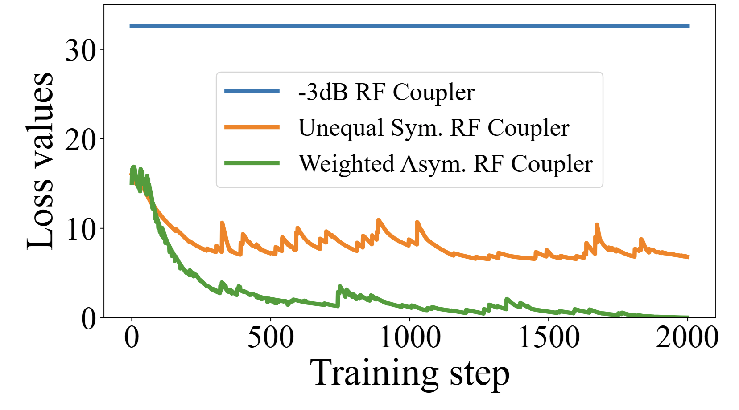
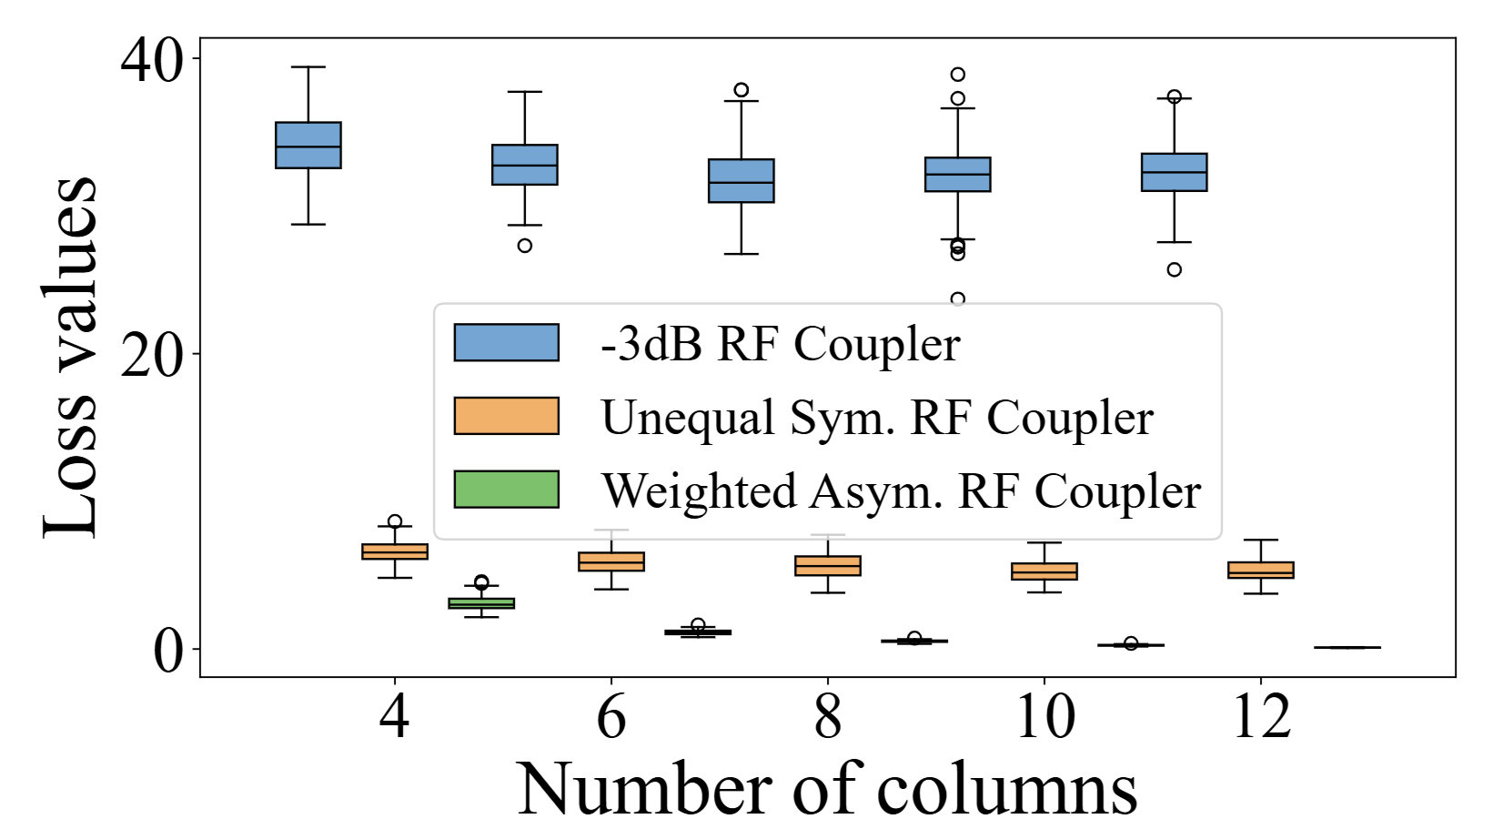
Fitting Ability of Different RF Coupler Networks
-3dB RF Coupler Network
Unequal Sym. RF Coupler Network
Weighted Asym. RF Coupler Network
Notes:
To demonstrate the necessity of our additional structures, we started by defining a random connection matrix and compared the fitting performance of three methods:
(1) using the original -3dB coupler,
(2) replacing the -3dB coupler unit with asymmetric coupler units, and
(3) employing the complete setup with unequal power splitters, tunable phase delay lines, and asymmetric coupler units for the final transmission matrix.
Comparison shows that the original -3dB coupler, lacking adjustment capability, produces a fixed and relatively high loss value against the target random matrix; when asymmetric couplers are used, the loss decreases but the network still cannot fully fit the random matrix. However, with the full configuration—integrating power splitters, combiners, and phase delay lines—our weighted asymmetric RF coupler achieves complete fitting of any random matrix.
We also evaluated the relationship between the number of coupling layers and fitting ability. As the number of layers increases, the -3dB coupler’s fitting capacity remains poor; with only asymmetric couplers, fitting ability improves; and finally, our proposed weighted asymmetric RF coupler consistently achieves perfect fitting for arbitrary random fully connected matrices.

Slide 16







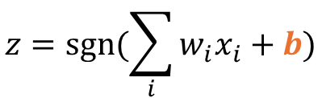

Bias Module: RF Shifters Supported Complex Value
$$1$$
$$x_{1}$$
$$b$$
$$w_{1}$$
RF attenuator
RF phase delay line
$$x_{2}$$
$$y$$
$$z$$
$$w_{2}$$
$$∑$$
sgn
port 1
port 2
$$D_{l}$$
$$x_{3}$$
$$w_{3}$$
$$R_{2}$$
port 1
port 2
$$z=sgn⁡(\sum_{i}{w_{i}x_{i}}+b)$$
$$R_{1}$$
$$R_{1}$$
$$L_{p}$$
RF phase delay line
RF GND
$$D_{p}$$
Port 1
Port 2
$$b={A e}^{jθ}$$
$$b=e^{jθ}$$
Notes:
Next, I will introduce the implementation of the bias module for neural network nodes.
In digital neural networks, the bias term helps the model shift in feature space, thereby enhancing the network's fitting ability. In WDNN, we have realized tunable "complex bias." Specifically, we connect a tunable attenuator and a phase shifter in series; the attenuator controls the signal amplitude while the phase shifter adjusts the signal phase. By combining these two components, we can generate any desired complex bias. This enables each neuron to independently control both the "signal strength" and "signal phase," achieving flexible complex bias adjustment.

Slide 17

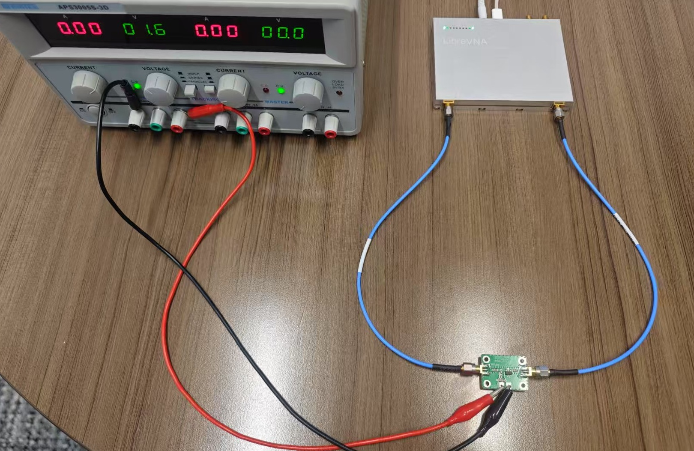

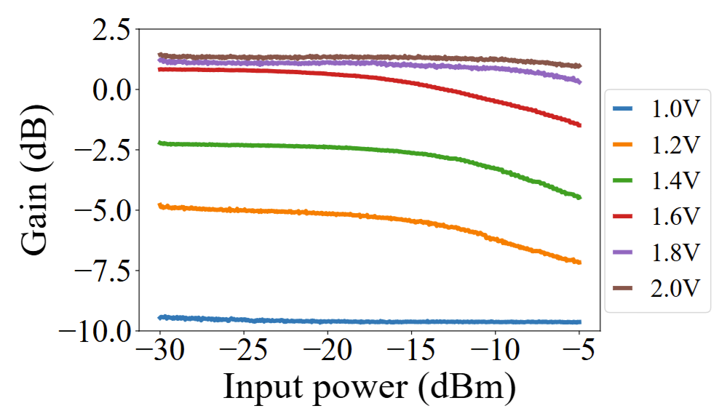
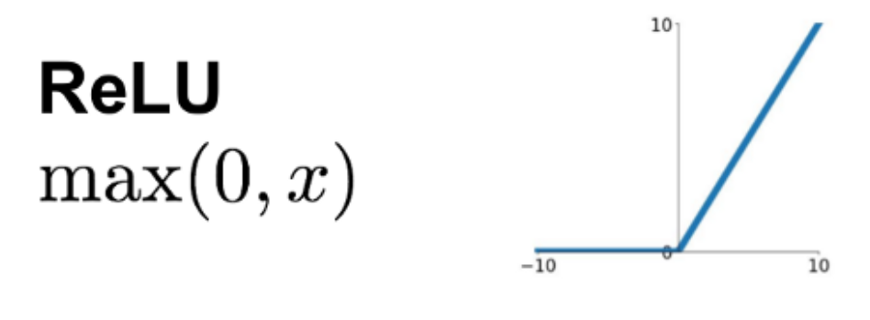




Non-linear Activation Module
GND
Vcc
$$C_{A}$$
Power supply
LibreVNA
RF Amplifier
$$L_{A}$$
RF in
RF out
RF amplifier
$$C_{B}$$
$$C_{B}$$
GND
Notes:
As we know, nonlinear activation functions are the soul of neural networks—without them, a network becomes a linear system and cannot learn complex mappings.
In digital neural networks, we can directly use functions like ReLU or Sigmoid. However, implementing nonlinearity in analog circuits is much more challenging.
Our solution is to leverage the inherent nonlinearity of RF amplifiers. When an amplifier operates in the saturation or cutoff region, its input-output characteristics exhibit significant nonlinearity. By lowering the supply voltage, we can make the amplifier enter mild saturation, resulting in a response similar to ReLU: when the input signal is low, the output is close to zero; once the input exceeds a threshold, the output rises rapidly.
This design is highly innovative—it harnesses the intrinsic physical properties of hardware to realize the activation function needed by the neural network.
From a system perspective, WDNN now possesses all three essential functional modules: weights, bias, and activation.

Slide 18
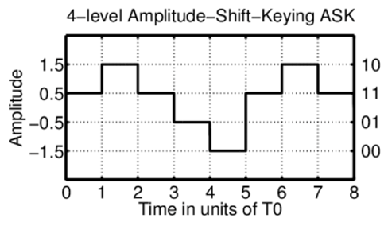

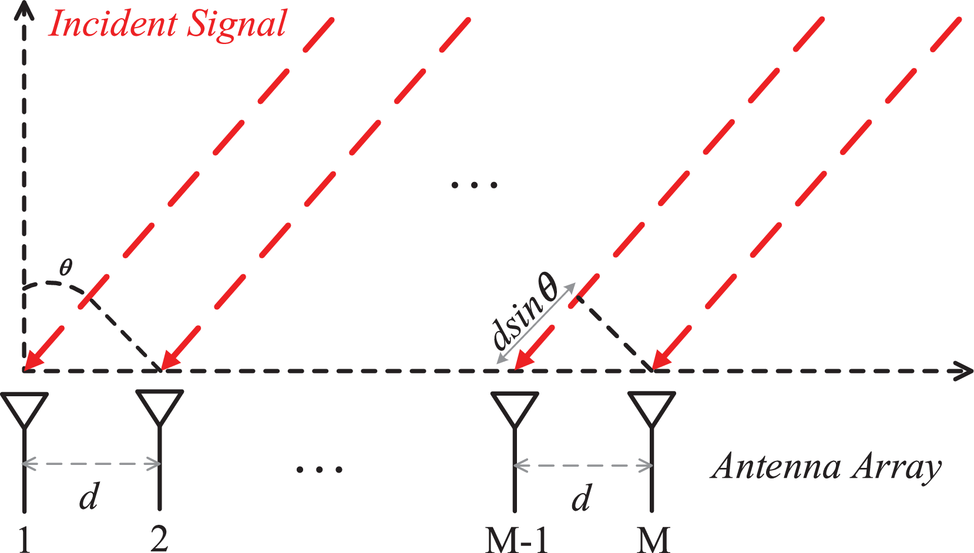
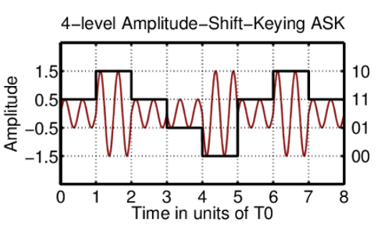
Applications
Amplitude shift keying
Angle of Arrival
Fall Dectection
Notes:
To validate the effectiveness of our device, we selected three mainstream applications to test the performance of our proposed WDNN system.
These include multi-level amplitude shift keying modulation, angle of arrival detection, and fall detection.

Slide 19
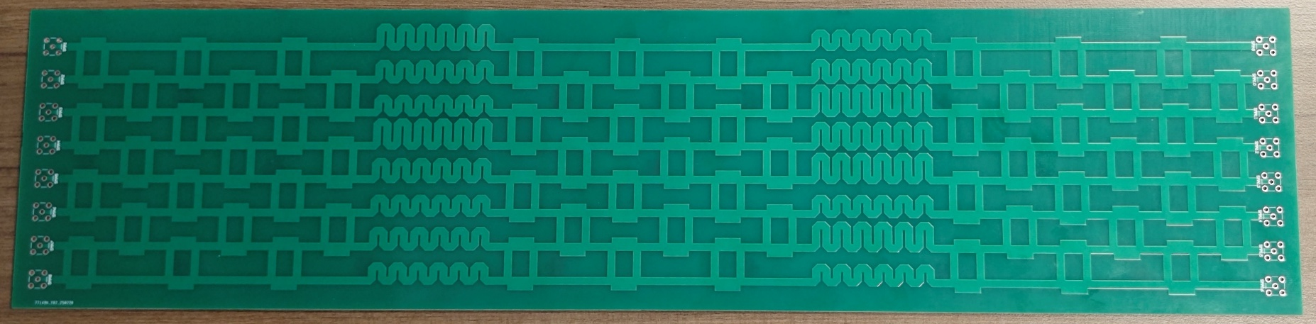
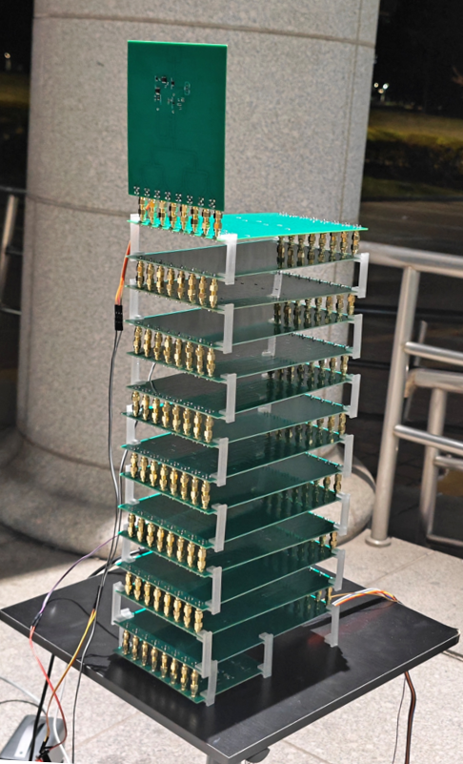
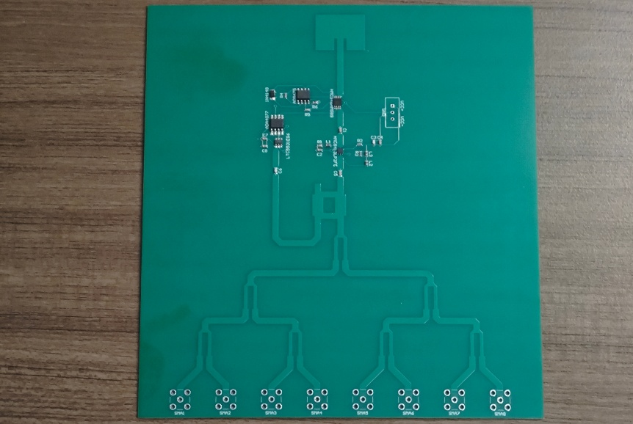
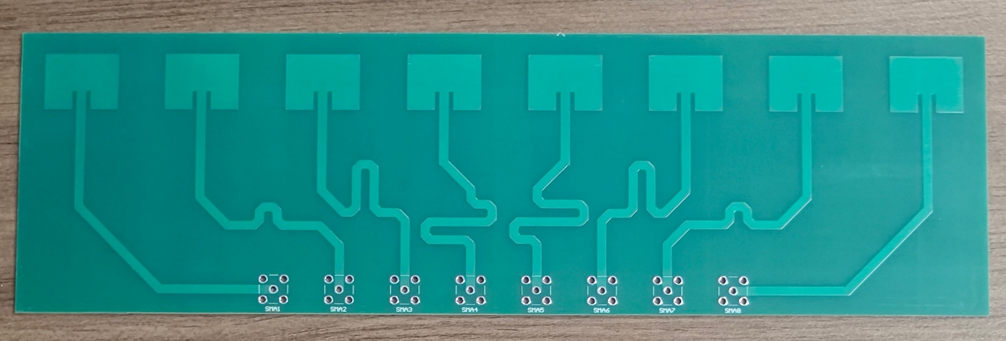
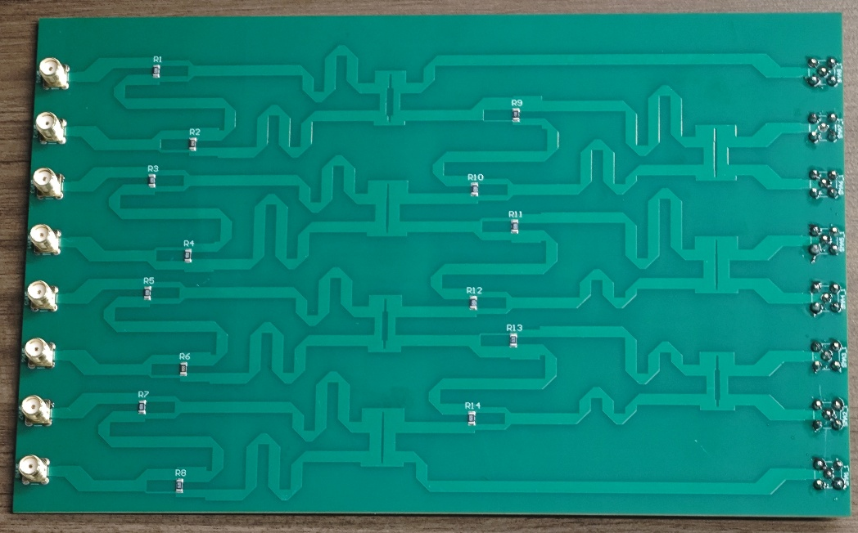
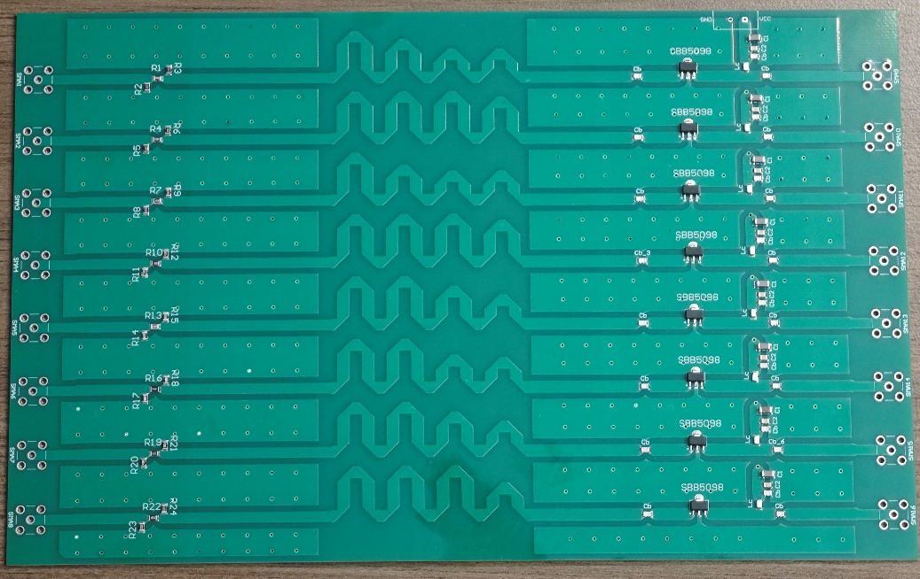
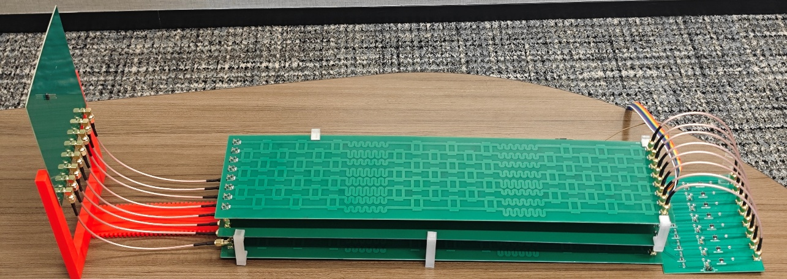
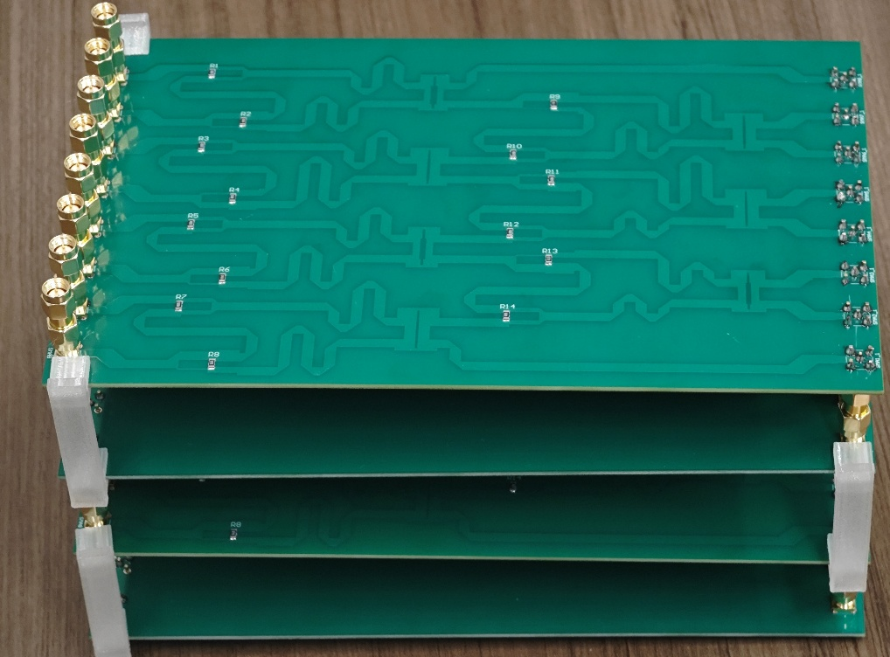
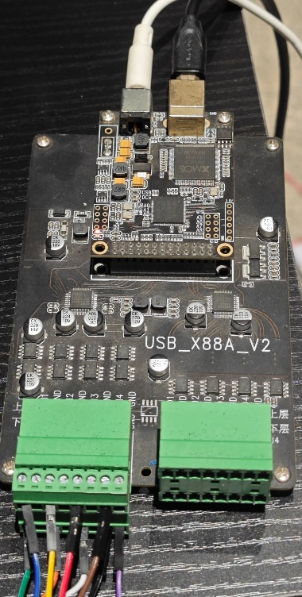
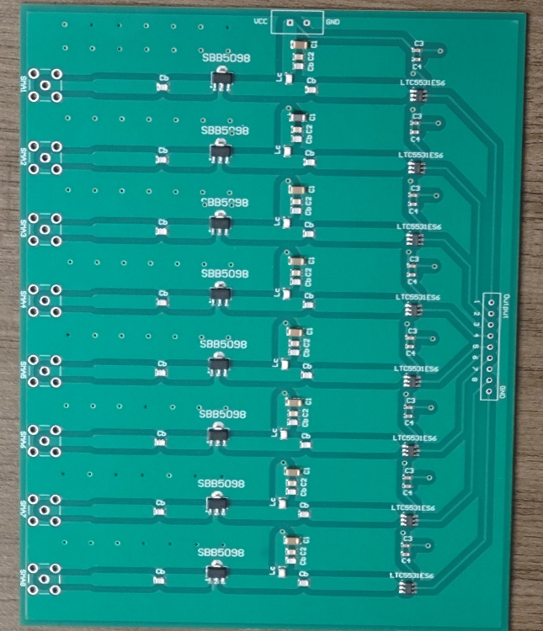














Input Layer:
Antenna
WDNN Prototype
Patch
antenna
Patch antenna array for AoA estimation tasks
RX Antenna
AGC
module
Power
splitter
$$W$$
$$b$$
$$W$$
$$b$$
$$W$$
Propagation
modules
Propagation
Module
($M=4, N=6$)
Bias
module
Input Module
Equal
RF coupler
Bias and
Activation
modules
(i)
Weighted asymmetric
RF coupler
(iii)
$$b$$
$$tau$$
antenna
Power detector array
Pla-NN
(13cm x 52cm x 6cm)
$$W$$
Bias
Module
Activation
Module
$$b$$
$$tau$$
(ii)
$$W$$
One propagation module between two layers
(iv)
Output Module
$$W$$
$$b$$
$$tau$$
$$W$$
Feature
output layer
4 layers as a
Propagation Module
($M=4, N=8$)
Feature output
Power detector array
ADC
device
Notes:
We built a WDNN prototype system in our laboratory.
The setup consists of four main components:
Receiving antennas to ensure constant ASK power and identical AOA phase;
The WDNN motherboard, based on couplers and phase shifters;
The bias layer and activation module;
Power detector and ADC for output measurement.
We used the standard 5GHz frequency band for all tests.
All modules are interconnected via RF cables, and the output is measured using an ADC device.

Slide 20
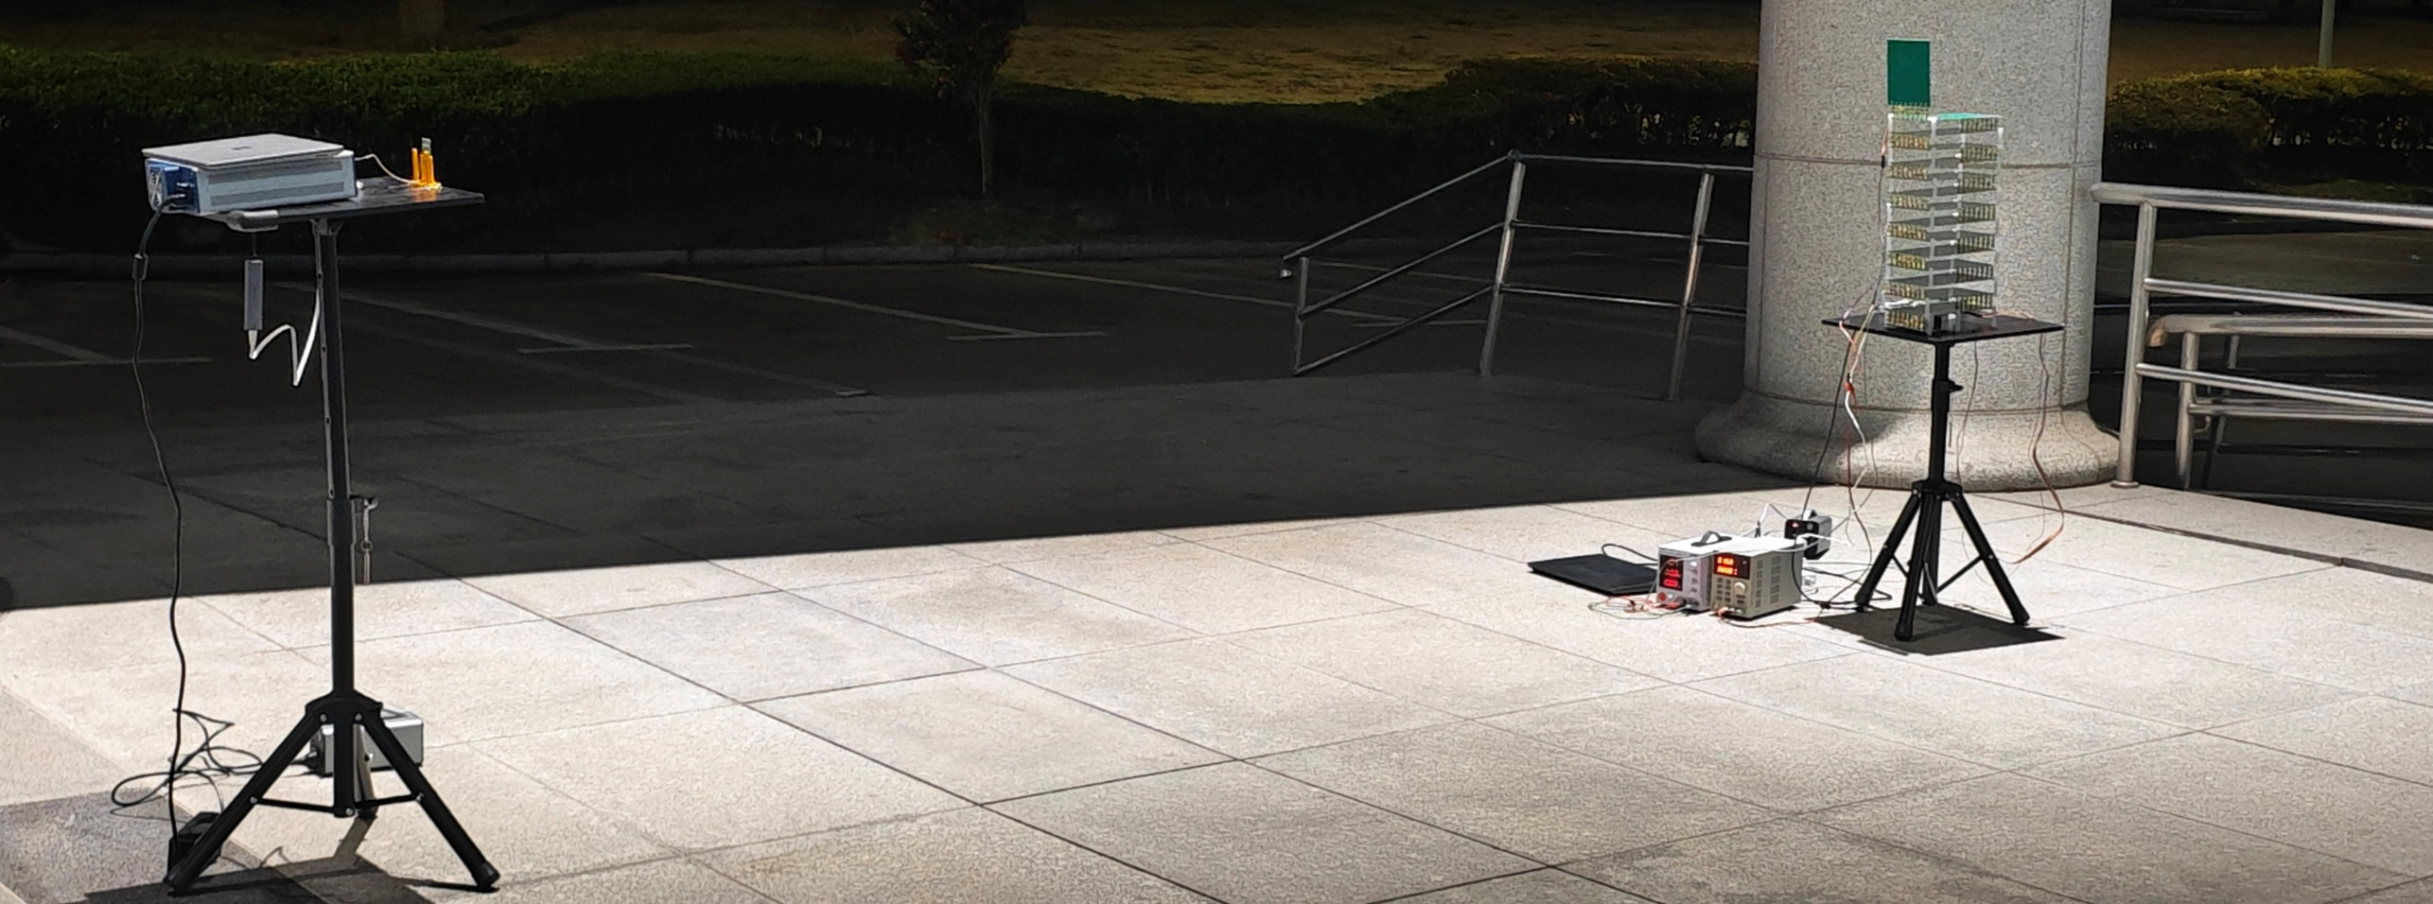
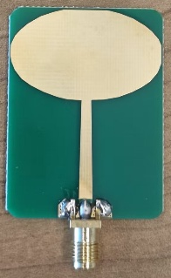
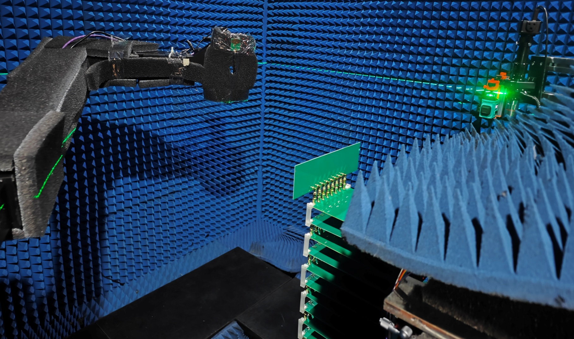




Experiment Setups
Laptop
Rx Antenna
Tx Antenna
USRP
2974
WDNN
Amplitude Modulation (AM)
Communication:
AM Decoding with WDNN
ADC
board
Laptop
Power
supply
Power
supply
5GHz
Antenna
Tx Antenna
Power
supply
$$Az$$
ADC board
$$El$$
Behind
RF Sensing:
AoA Estimation with WDNN
1x8
phased
array
RX
antenna
array
Bias and
Activation
modules
Propagation
modules
WDNN
Feature
output layer
Notes:
This is our experimental setup. During the experiments, we transmitted task-specific data to the WDNN system using a signal generator or USRP.
After analog propagation and processing by the WDNN, the results were read by a power detector at the output end and compared with the target labels.
These three tasks span different layers from communication signal recognition to wireless sensing and provide a comprehensive demonstration of WDNN’s versatility.

Slide 21




Performance
AM Decoding Performance
AoA Estimation Performance
Confusion Matrices:
32-level AM Decoding Performance
Confusion Matrices:
AoA (31-class) Estimation Performance
Notes:
Let’s first look at the AM decoding performance.
We generated 32-level amplitude modulation signals (AM-32) as the input. The objective was for WDNN to directly identify the symbol categories in the RF domain, eliminating the need for digital demodulation.
The results show that WDNN achieved a classification accuracy of 98.5%, while the state-of-the-art plane neural network-based diffractive network reached just 21.6%.
This result is significant—it demonstrates that WDNN not only "sees through" electromagnetic waves for signal identification, but can also directly accomplish modulation decoding.
This means that in future communication systems, WDNN could perform part of the neural computation before signals are digitized, greatly reducing processing latency.
The second experiment was angle of arrival (AOA) estimation.
Using a multi-antenna array, we tested signals from 31 angles ranging from -75° to +75°.
The task was for WDNN to determine the direction of incoming signals based solely on received RF data.
WDNN achieved a classification accuracy of 93.7%, while the comparison plane diffractive network reached only 16.9%.
This shows that WDNN can capture subtle phase and amplitude variations in RF signals and accurately map them to spatial angle information.
Such spatial sensing capability makes WDNN highly suitable for positioning, posture recognition, and RF sensing scenarios.
The third experiment was Wi-Fi-based fall detection.
We collected various human movement signals in a room, such as standing, walking, and falling.
All signals were sampled via Wi-Fi CSI and then classified in real time by the WDNN hardware.
The results indicate that WDNN achieved a classification accuracy of 90.8%, which is 27.5% higher than the state-of-the-art RF sensing methods.
This demonstrates that our physical neural network can handle communication signals and is highly effective for dynamic sensing tasks.
Notably, WDNN showed excellent robustness in challenging indoor multipath environments.

Slide 22


Performance
Ablation study results showing performance
variation with the proposed propagation modules and
nonlinear activation modules.
Performance comparison with the baseline
diffractive NNs and digital deep learning methods.

Slide 23
© MobiCom 2025
Hong Kong, China
WDNN: Weighted Diffractive Neural Network for Physical-layer RF Signal Processing
Thanks for Listening!
Any questions: yezhouwang@sjtu.edu.cn
Notes:
This concludes my presentation. Thank you all for your attention. If you are interested in the implementation details or the experimental system, I would be glad to discuss further with you after the session.
Thank you!

Slide 24


Coupler/Delay line test

