Slide 1




HandPad: Enabling On-the-Go Writing on Your Hand via Human Capacitance
Yu Lu†, Hao Pan†, Dian Ding†*, Yijie Li†, Juntao Zhou†,
Yongjian Fu ♦, Yongzhao Zhang‡, Yi-Chao Chen†, Guangtao Xue†
Shanghai Jiao Tong University†
Central South University ♦
University of Electronic Science and Technology of China‡
Notes:
Good morning, my name is XXX, from XXX
I am pleased to introduce the work ‘HandPad: Enabling On-the-Go Writing on Your Hand via Human Capacitance’.

Slide 2

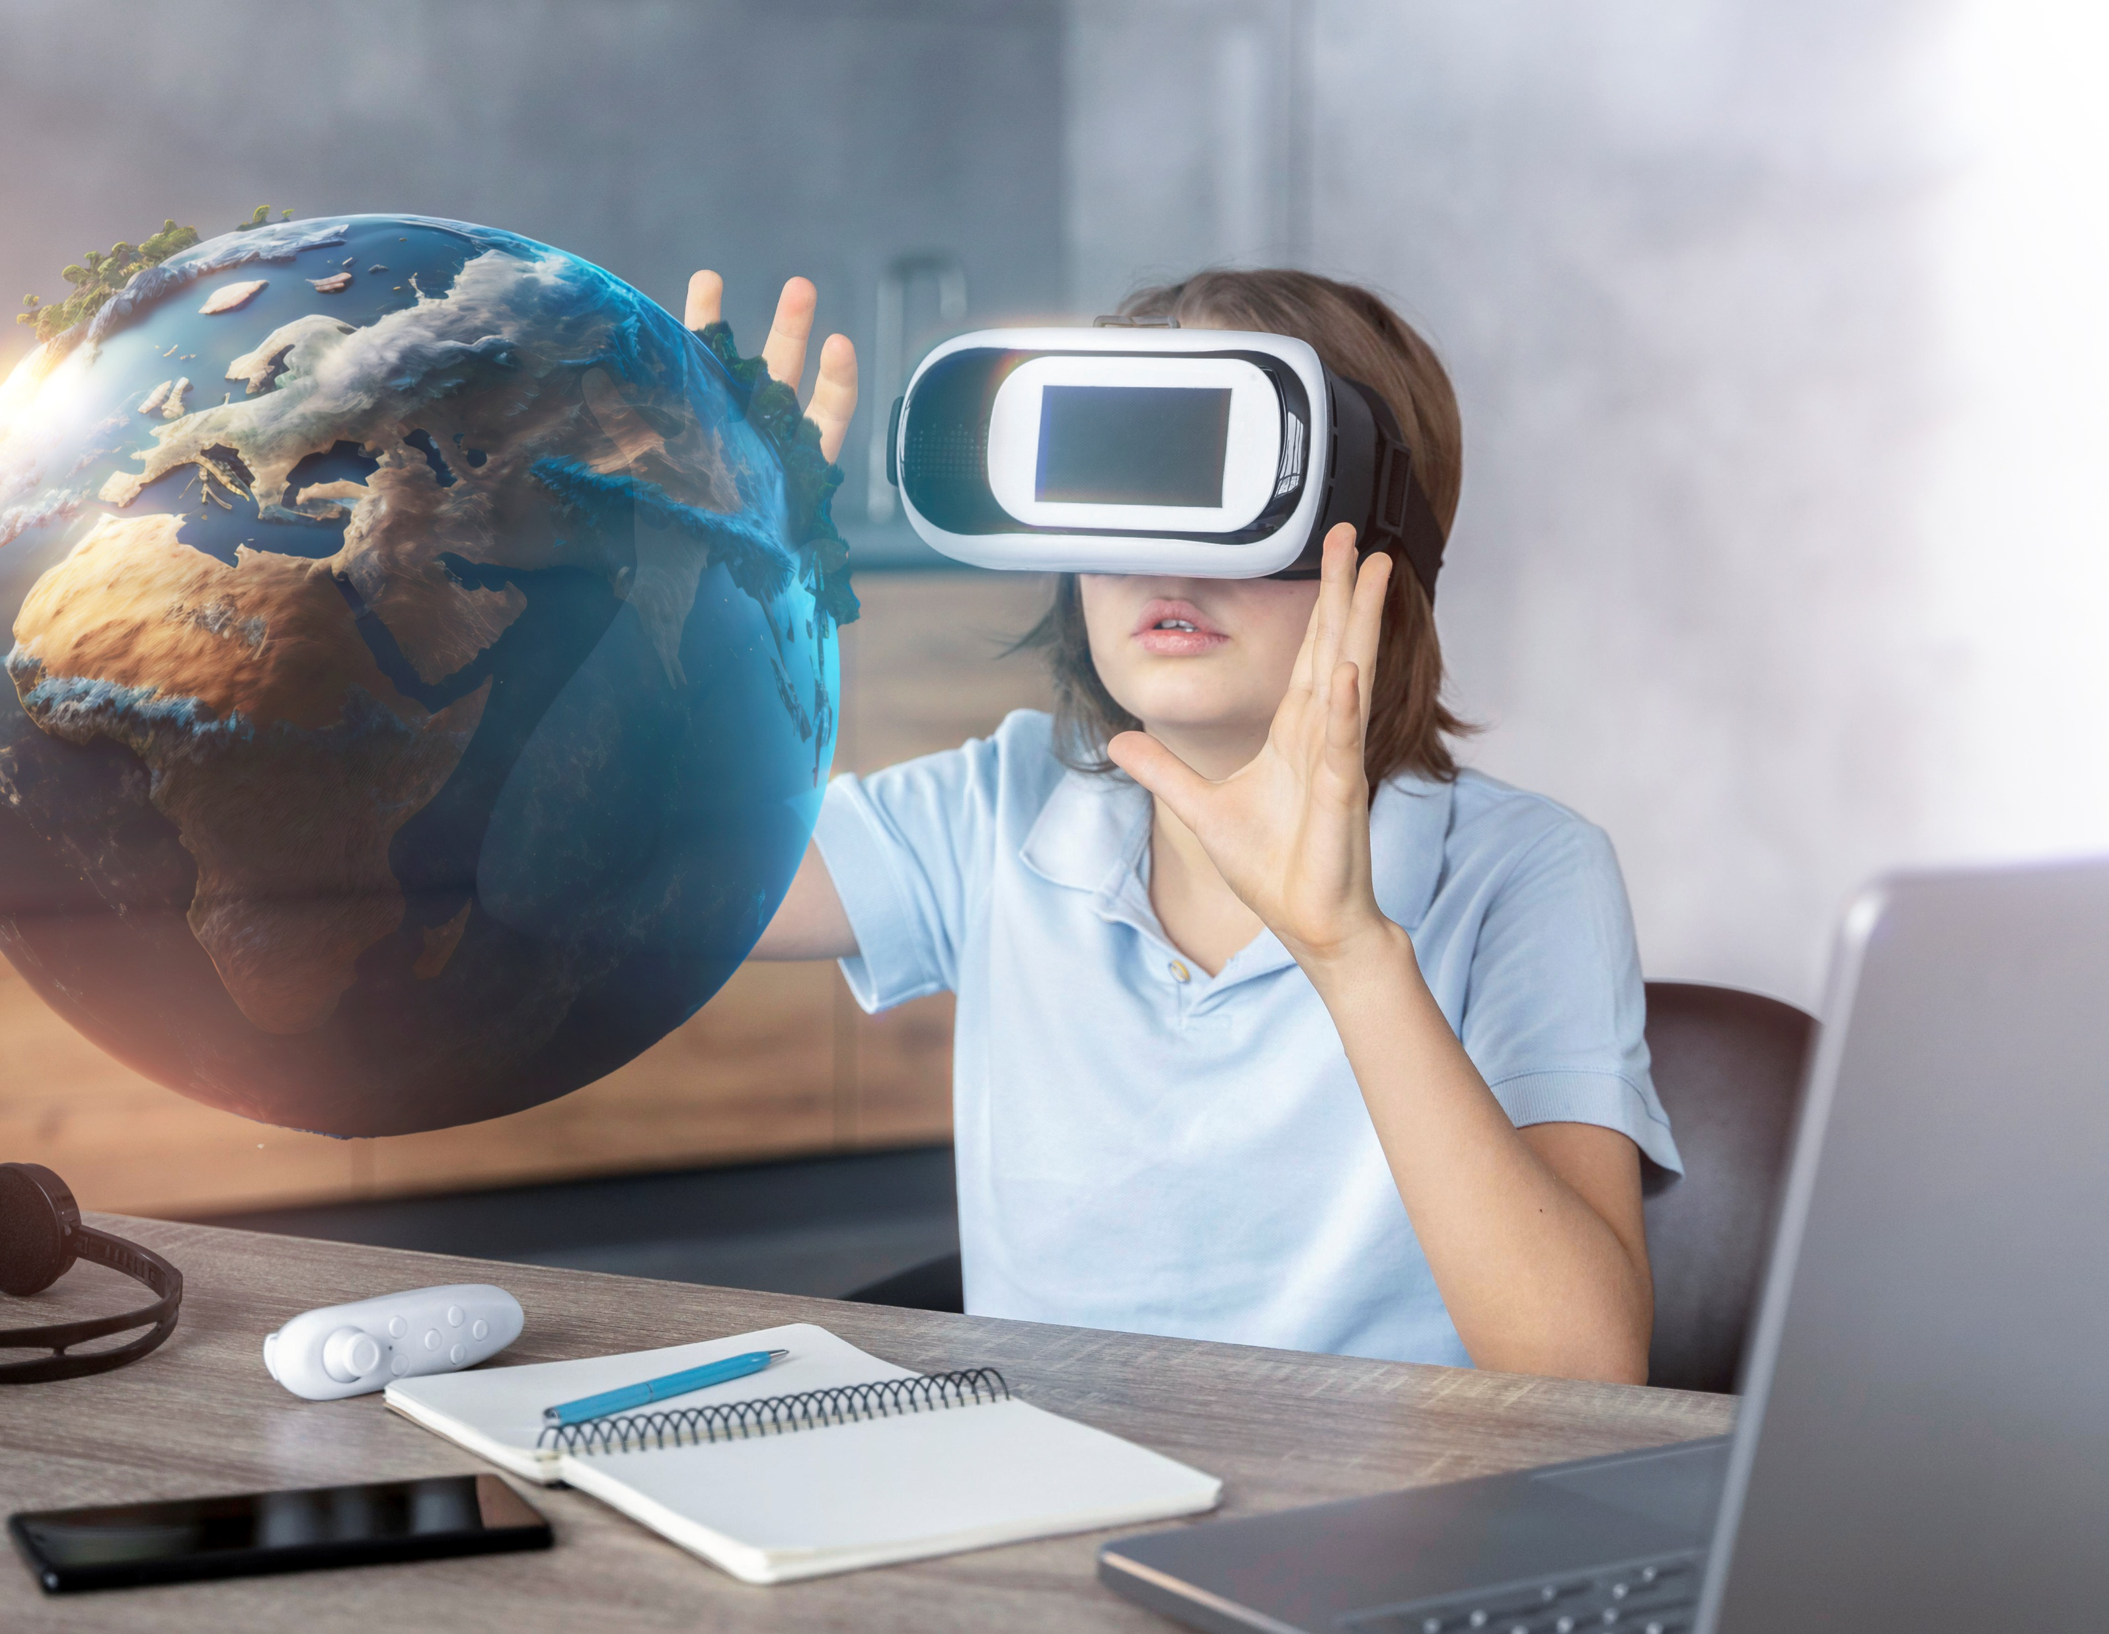
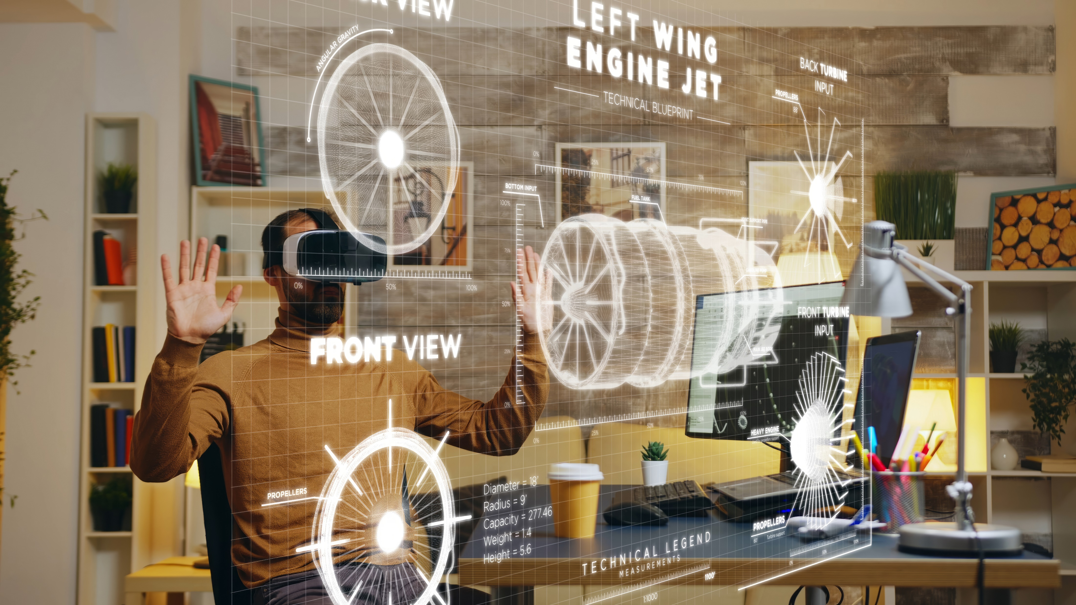
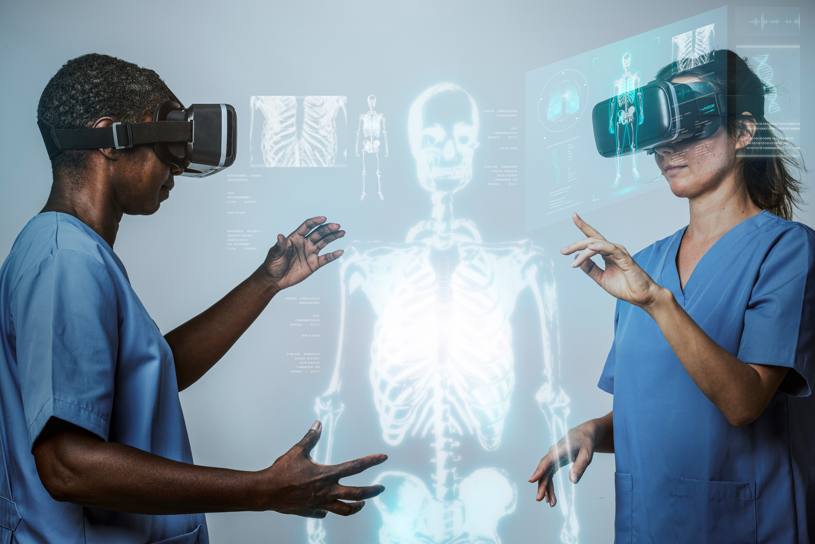
Background
Immersive Entertainment
Education and Researches
Training and Simulation
Medical Treatment and Remote Inquiry
Notes:
We know that VR and AR have been applied in many areas:
From Immersive Entertainment, Job Training, Medical Treatment, Remote Inquiry, and many other aspects

Slide 3
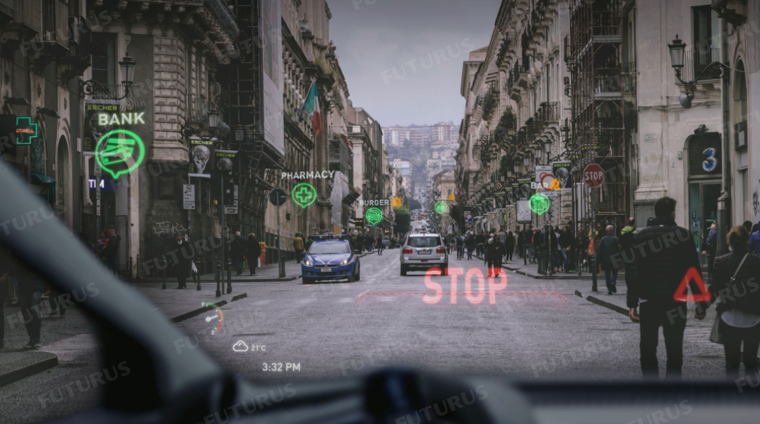


Background
Text input for VR/AR
Precision
Customization
Privacy
Notes:
[click]
Text input is critical for AR/VR systems because it enables precision, control, and privacy.
[click]
Firstly, it allows for precise communication, ensuring accuracy when entering complex commands or detailed messages.
[click]
Secondly, text input offers customization and control by letting users modify settings or virtual objects with specific commands.
[click]
Lastly, it ensures privacy and accessibility in public spaces, allowing users to input sensitive information discreetly.

Slide 4
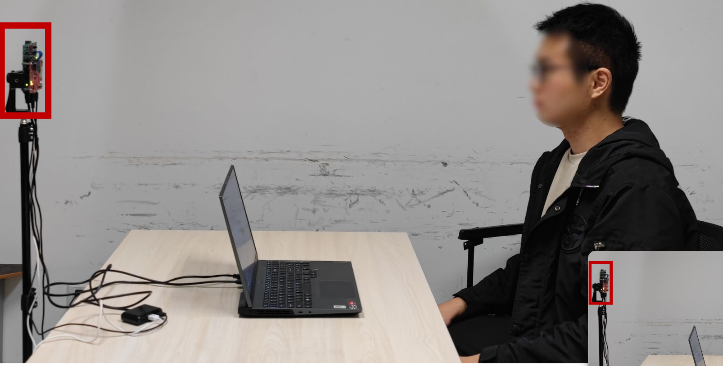
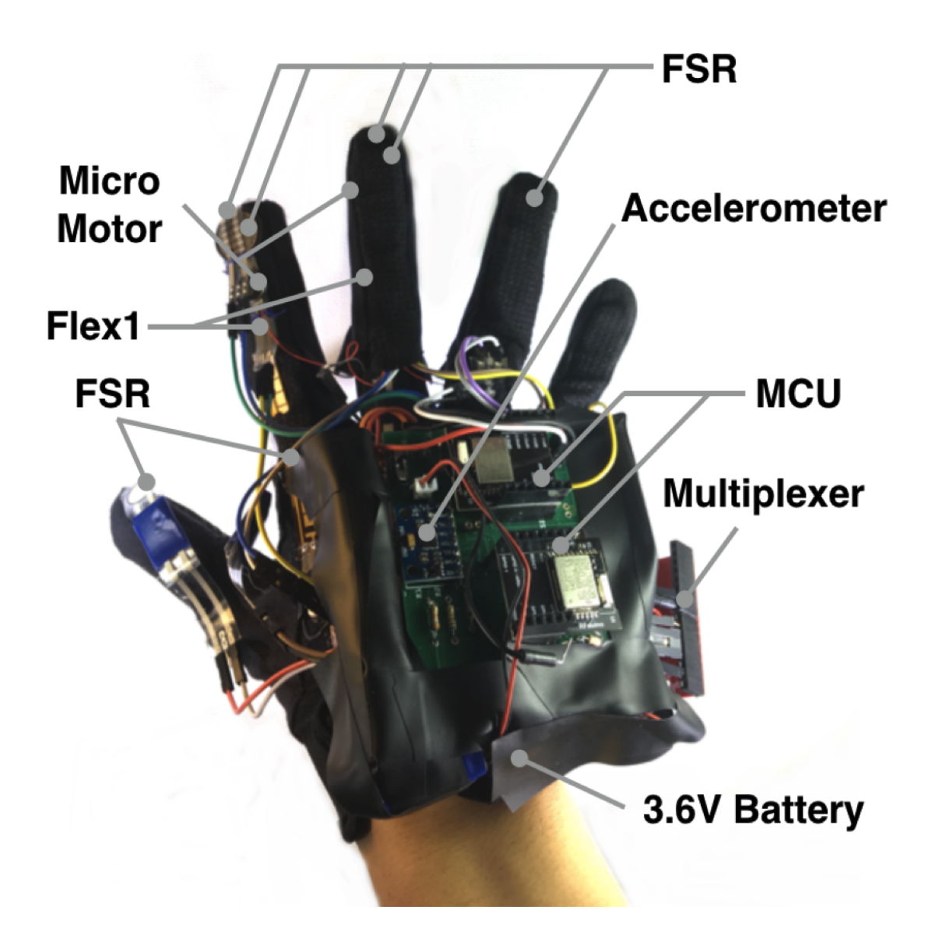
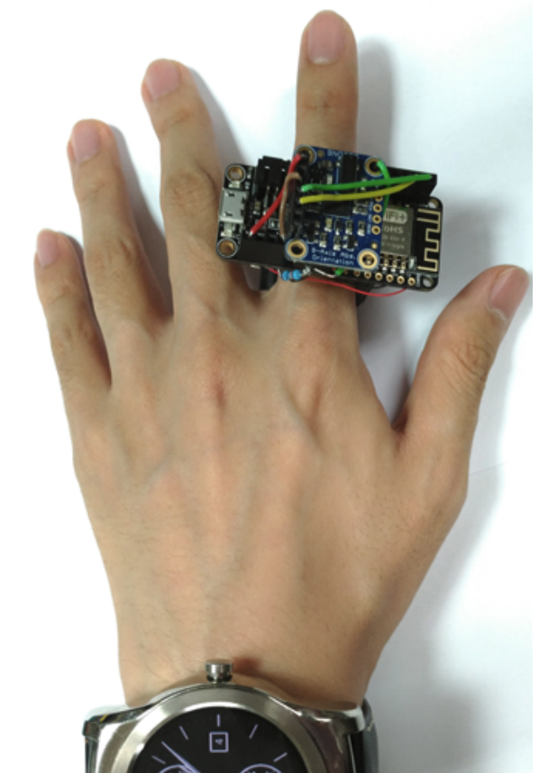
Existing Methods
Wireless
Inertial Sensor
Signal Recognition
Privacy & Disturbance
Sensor Deployment
Glove
Ring
Notes:
There are two main types of existing text input systems
[click]
Wireless systems rely on signal processing for text input,
[click]
but both are vulnerable to ambient noise and raise privacy concerns in public spaces.
[click]
Inertial sensor-based solutions rely on gloves or rings to enable deployment of sensors on each finger for fine-grained gesture recognition or text handwritting input.
[click]
Howerever, the existing work relies on the sensor matrix and the commonly used pressure sensor matrix suffers from jitter, jumps, and nonlinear artifacts.

Slide 5
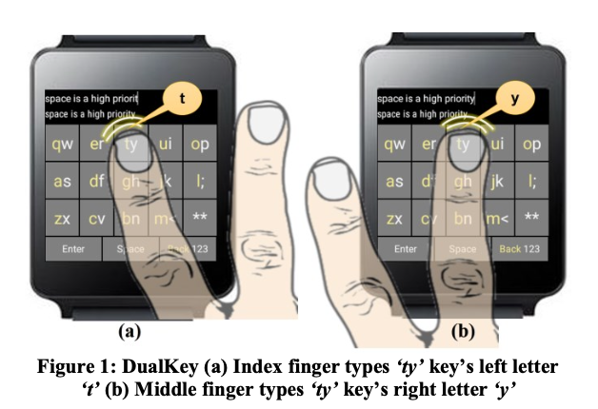
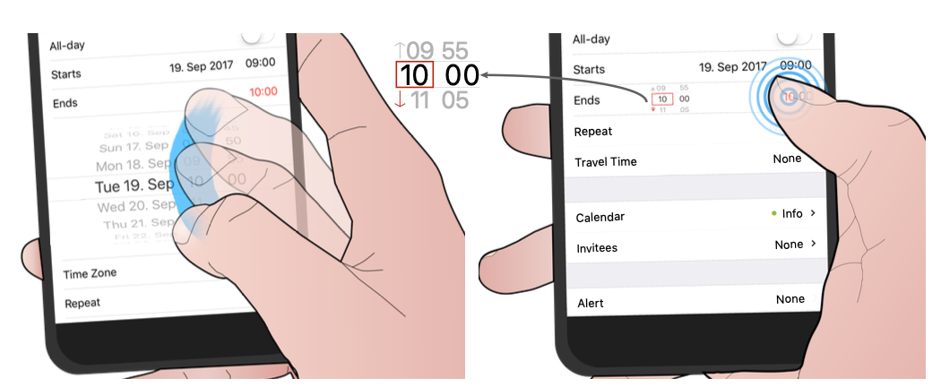
More Suitable Method ？
Inspired by touchscreen input
Human Capacitance ？
Different finger
Different force
Notes:
We were inspired by touchscreen input interactions of the recent researches. 【click】【click】
Capacitive touchscreens can sense different fingers and different strengths when touching the screen. 【click】
which provided the inspiration for human capacitance to sense hand touch. And human capacitance is a direction worth exploring.

Slide 6
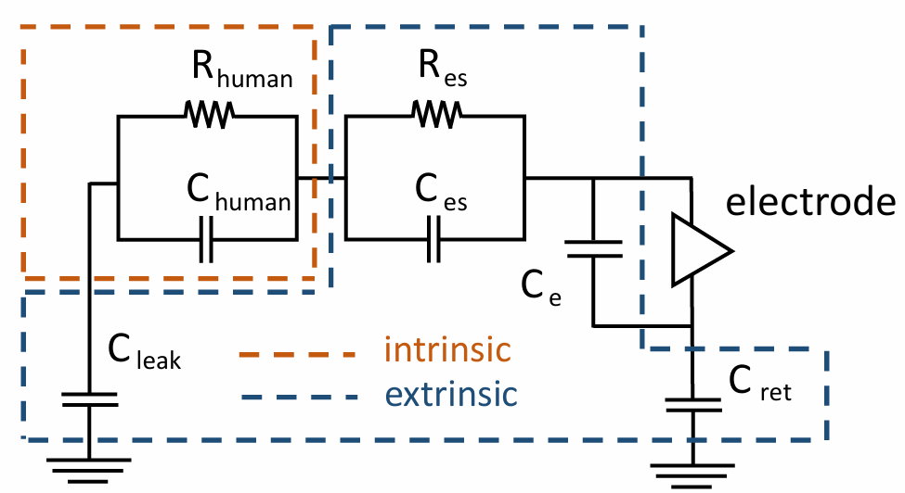
Our Finding
Human Capacitance Model
Modulated by extrinsic capacitance
Notes:
Here is our finding on the human capacitance sensing.
【click】
Human tissues possess corresponding electrical properties and can be modelled as capacitive and resistive circuits.【click】
The two formulas can be written as C-tissue and R-tissue.
The human body capacitance can be modelled as follows：【click】
including the intrinsic capacitance of the human tissues 【click】
the extrinsic capacitance constructed between the human body and the ground 【click】
and the extrinsic capacitance constructed between the human body and the electrodes.【click】

Slide 7
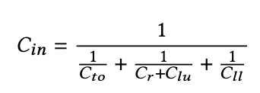
Our Finding
Human Capacitance Model
Modulated by intrinsic capacitance
（touch on human body）
change with the touch point
Notes:
In addition to extrinsic capacitance, we found that intrinsic capacitance can be modulated by contact points on the human body.【click】
The human tissue is modelled as shown in Figure.
[click]
Changes in the position of the contact points can modulate the two human capacitors in the left arm.【click】
By touching, the human body capacitance can be transformed into a corresponding capacitive parallel circuit.
【click】
Since the equivalent capacitance of human tissue is related to its length and cross-section.
【click】
As the position of the touch point changes, the lengths of the corresponding parts of Clu and Cll in the circuit change, thus changing the human capacitance values of the corresponding tissues.

Slide 8
Feasibility
Capacitive Sensors Locate Touching Point
Notes:
Therefore, we can achieve precise positioning of the touch point by human capacitance.
It can be seen that as the touch point moves from the fingertip to the wrist, the captured body capacitance gradually decreases.
【click】
Furthermore, touch point positioning for multiple fingers can be achieved through multiple channels. And the modulation of human capacitance by touch points is similar across fingers.

Slide 9
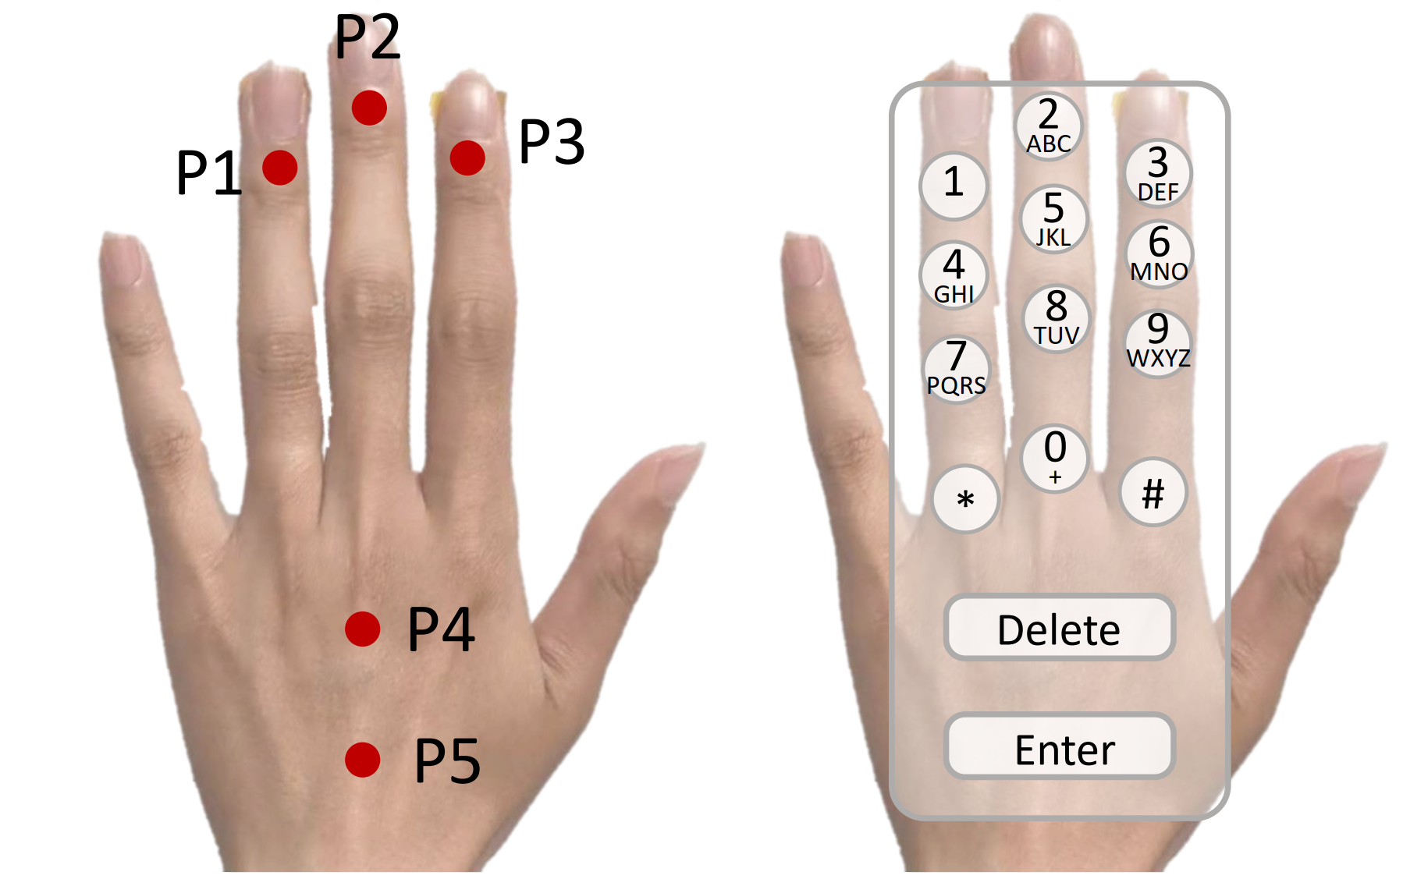
Feasibility
Human Capacitance Modulated by Touching Point
Notes:
We set up 4 button positions for each of three fingers to implement a traditional 9-grid keyboard on the hand.

Slide 10
Feasibility
Human Capacitance Modulated by Touching Point
Notes:
Based on the touch point positioning, we further validate the continuous tracking of touch points.
We performed two line tests. Firstly, by sliding horizontally on three fingers 【click】
the positioning of the contact points on the three fingers remained stable.
【click】【click】
The second was slid di`agonally upwards, 【click】
with the position of the contact point gradually moving upwards. 【click】【click】
It can be seen that the system is capable of coarse-grained 2D continuous localisation.

Slide 11
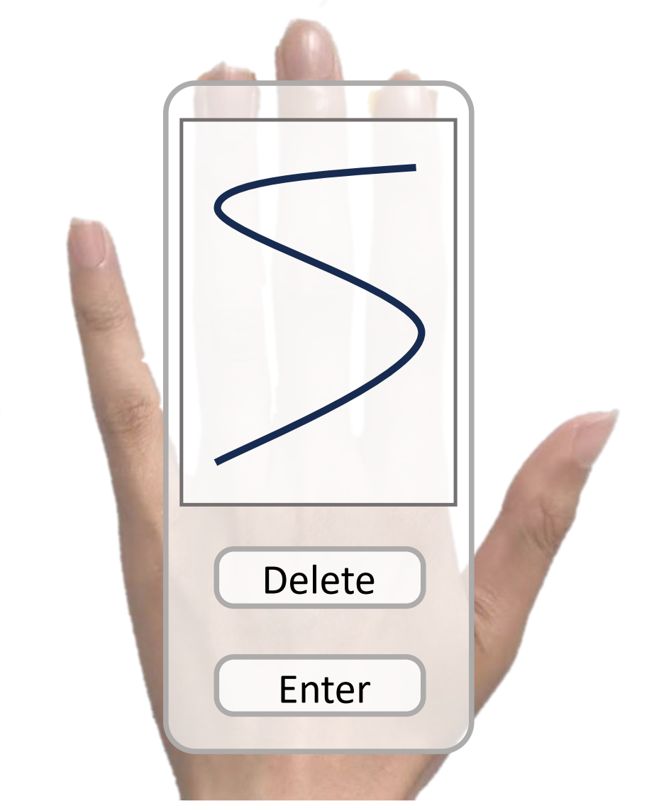
System Setup
capacitive sensing system for handwriting interface
Notes:
Our system setup is shown in Figure, we similarly deployed capacitance sensors at the wrist, [click] the system only requires the deployment of electrode finger cuffs at the fingertips to capture body capacitance.【click】
The three-channel capacitive sensor converts the user's hand into an interactive interface, allowing for hand keystrokes and handwritten interfaces.

Slide 12
System Overview
Notes:
Here is the system overview.
Based on the above capacitive modulation system, we have implemented portable keystrokes and handwriting recognition using capacitive sensors.

Slide 13
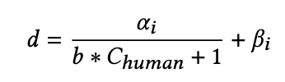
Signal Preprocess
1. Finger Model
2. Preprocess
Gaussian Filter
Notes:
Then, we introduce the signal preprocess
【click】
We fitted the finger model using an inverse proportional function, and as the back of the hand and the finger possess different cross-sectional areas, we fitted them separately.
Then, considering the inconsistency in finger lengths, we scaled and translated three finger models.
【click】
The system uses a Gaussian filter to smooth the signal segments of the human capacitance,
which mitigates the fluctuations caused by sensor noise.

Slide 14
Keystroke
1. Calibration
Finger Model
2. Keystroke
Preprocess
Segmentation
Recognition
Notes:
First, we introduce a keystroke system based on intrinsic capacitance in the human body.
The recognition consists of the following steps
【click】
First, the user touches a specific location on the back of the hand for finger modelling
【click】
Based on the finger modelling, the system pre-processes， segment the capacitance signal, and achieve keystroke recognition.

Slide 15
Handwriting Input
1. Dataset Collection (underlying dataset)
Handwriting Number (0 - 9)
Handwriting Letter (A - Z)
Handwriting Chinese Stroke
26 strokes to 19 classes
Notes:
Then，we build the ubderlying dataset for different types of handwritten inputs.
【click】
We capture the capacitive signals of handwriting through fingertip electrodes.
【click】
Including handwritten numbers,
【click】
letters
【click】
Considering that some of the strokes are extremely similar under a limited number of channels. In order to improve the recognition accuracy, we combine the similar strokes into one category, and thus classify the 26 Chinese strokes into 19 categories.

Slide 16
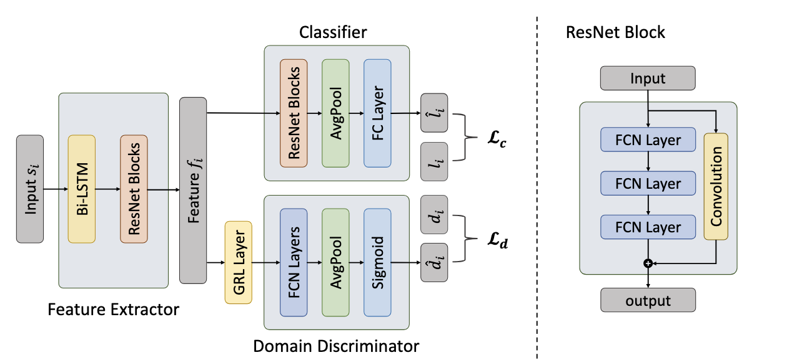
Handwriting Input
2. Signal Recognition
1. Underlying Model
2. Domain Adversarial
Neural Network
Target User
Dataset
3 samples for each input
Domain Transfer
3. Sequence Matching
Chinese Character
Notes:
The recognition process includes the following
【click】
First train the base model with the underlying dataset
【click】
Secondly, collect data for the target user and train the user model using domain transfer method
【click】
It is worth noting that the target user only needs to collect 3 samples for each handwritting input.
【click】
Then, implement Chinese character recognition based on handwriting strokes with sequence matching.

Slide 17
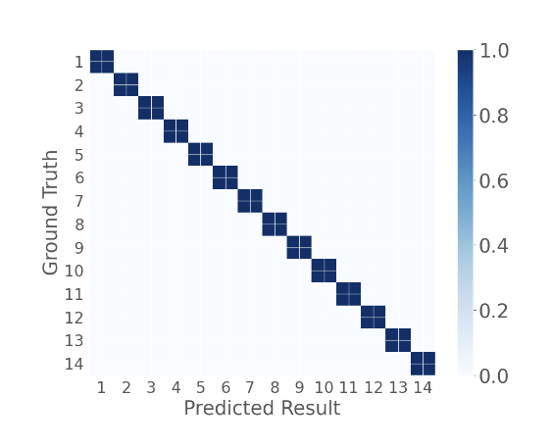
Evaluation - Keystroke
Average Accuracy: 100%
Notes:
Here is the evaluation of our system. For keystroke recognition, We have 12 buttons on the fingers to satisfy the need for number and letter keystrokes,
【click】
and confirmation and delete buttons on the back of the hand.
【click】
【click】
the confusion matrix for different keystroke accuracies is shown in Fig. The system achieves 100% recognition accuracy.

Slide 18

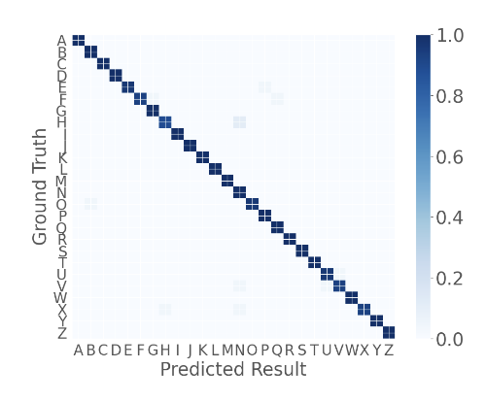
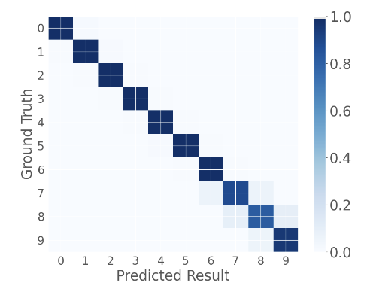
Evaluation - Letter and Number
Letter Accuracy
99.1%
Number Accuracy
97.6%
Notes:
Here is evaluation of the different handwritting recognition.
【click】
For the handwriting letter, the system achieved 99.1% recognition accuracy.
【click】
For the handwriting number, the system achieved 97.6% recognition accuracy.

Slide 19
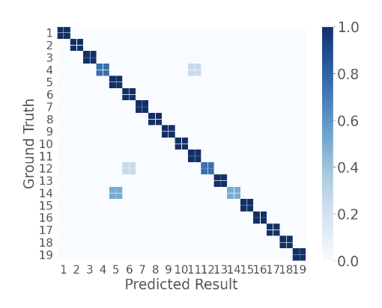
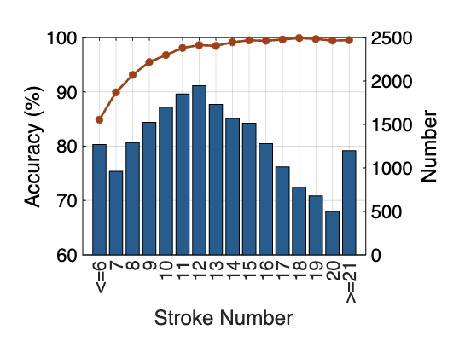
Evaluation – Chinese Character
20795 Chinese Character
Stroke Accuracy
94.6%
Character Accuracy
97.9%
Notes:
【click】
For the handwriting chinese stroke, the system achieved 94.6% recognition accuracy.
【click】
Based on this, the system achieved 97.9% recognition accuracy for 20795 Chinese characters.

Slide 20
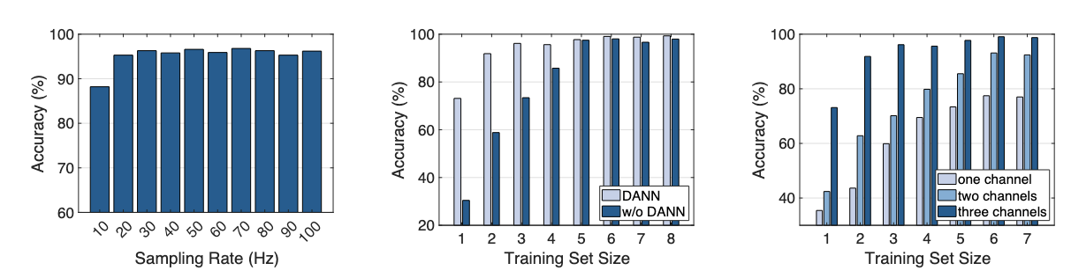
Evaluation
DANN Reduce over 110
training samples
Influence of
sampling rate
Influence of
training set size
Influence of
channel size
Notes:
【click】
A high sampling rate raises the cost of hardware devices and the threshold for system deployment. In this experiment, we verified the impact of sampling rate on
keystroke and handwriting recognition. As shown in the figure has a low sampling rate requirement and can be easily integrated into other devices as an interactive system.
【click】
The dataset size of the target user still has an impact on the performance of the system. In this experiment, we verify the effect of the training set size on the
recognition accuracy of the system in transfer learning.
【click】
For three handwriting inputs, the overall training set samples can be reduced by over 110 samples.
【click】
Finally, we attempt to further reduce the channel size of the capacitive signal. To ensure high recognition accuracy, we used three channels to acquire the capacitance signal.

Slide 21
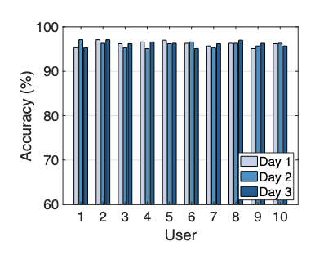
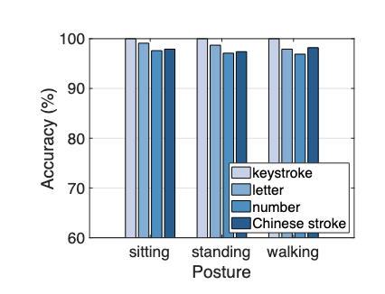
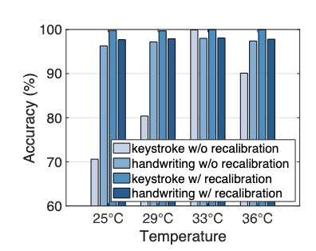
Evaluation
For more detail about the evaluation,
please refer to our paper.
Influence of
different user
Influence of
different environment
Influence of
different temperature
Notes:
【click】
Recent researches confirmed the differences in human capacitance between users. Although different users usually differ in terms of writing trajectory, writing speed, etc., the system builds recognition models for these target users.
【click】
The recognition accuracy of the system in two different environments is shown in Figure and the system does not need to be retrained for different environments.
【click】
Experimental results indicate that when hand temperature varies from 25◦𝐶 to 36◦𝐶,the accuracies remain stable with recalibration.
【click】
For more detail about the evaluation, please refer to our paper.

Slide 22
HandPad: Enabling On-the-Go Writing on Your Hand via Human Capacitance
Thank you !
Yu Lu†, Hao Pan†, Dian Ding†*, Yijie Li†, Juntao Zhou†,
Yongjian Fu ♦, Yongzhao Zhang‡, Yi-Chao Chen†, Guangtao Xue†
Shanghai Jiao Tong University†
Central South University ♦
University of Electronic Science and Technology of China‡
dingdian94@sjtu.edu.cn
Notes:
That’ s all, thanks for your attention!

